Slide 1
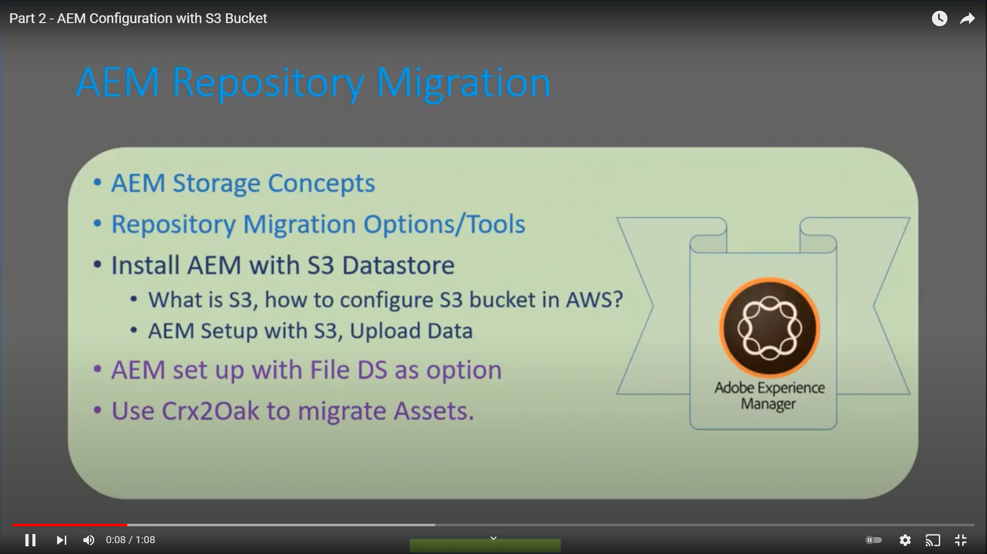
Migration Concepts

Slide 2
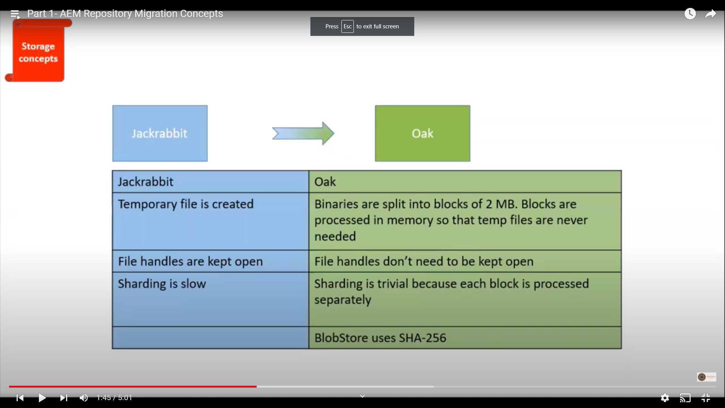
Migration Jackrabbit vs Oak

Slide 3
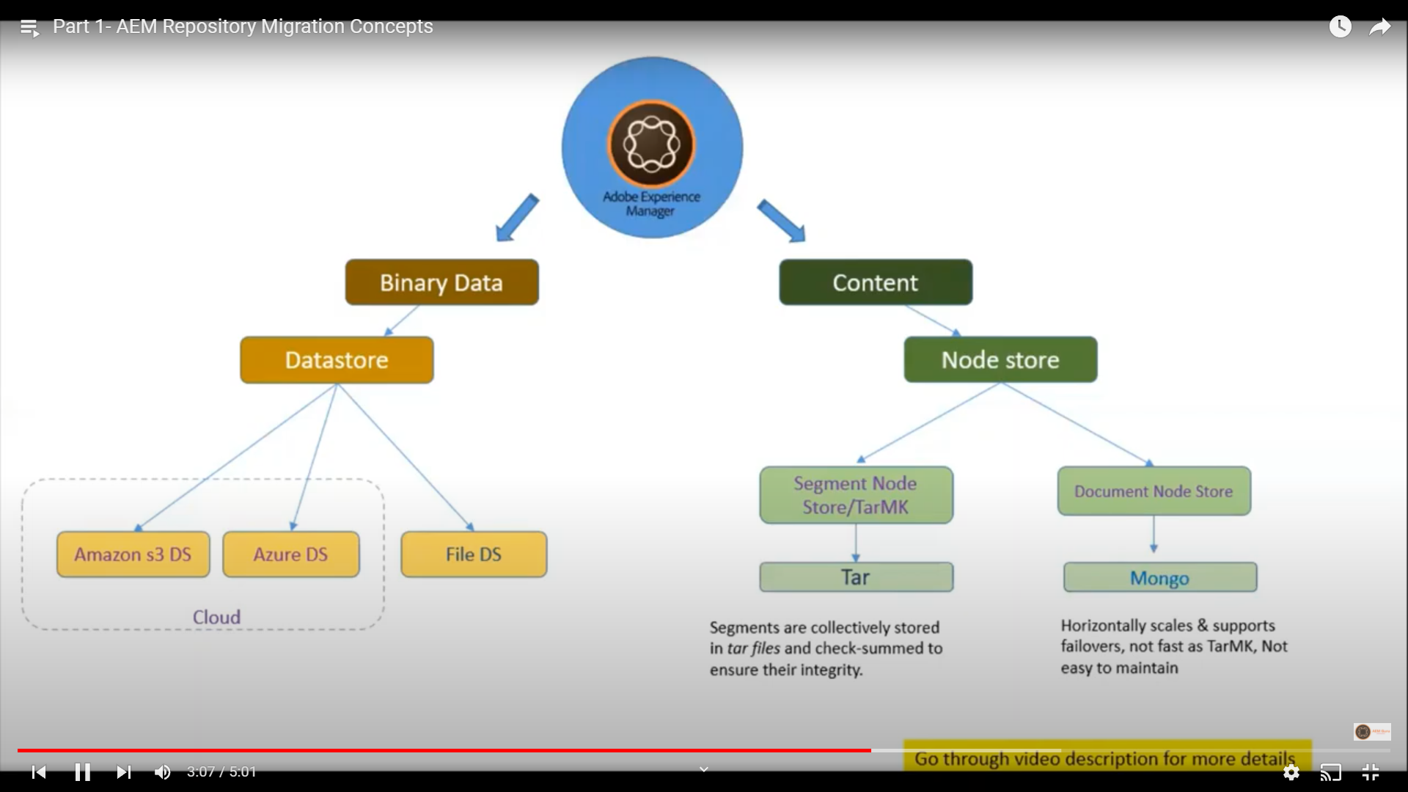
AEM Repository Binary vs Content

Slide 4
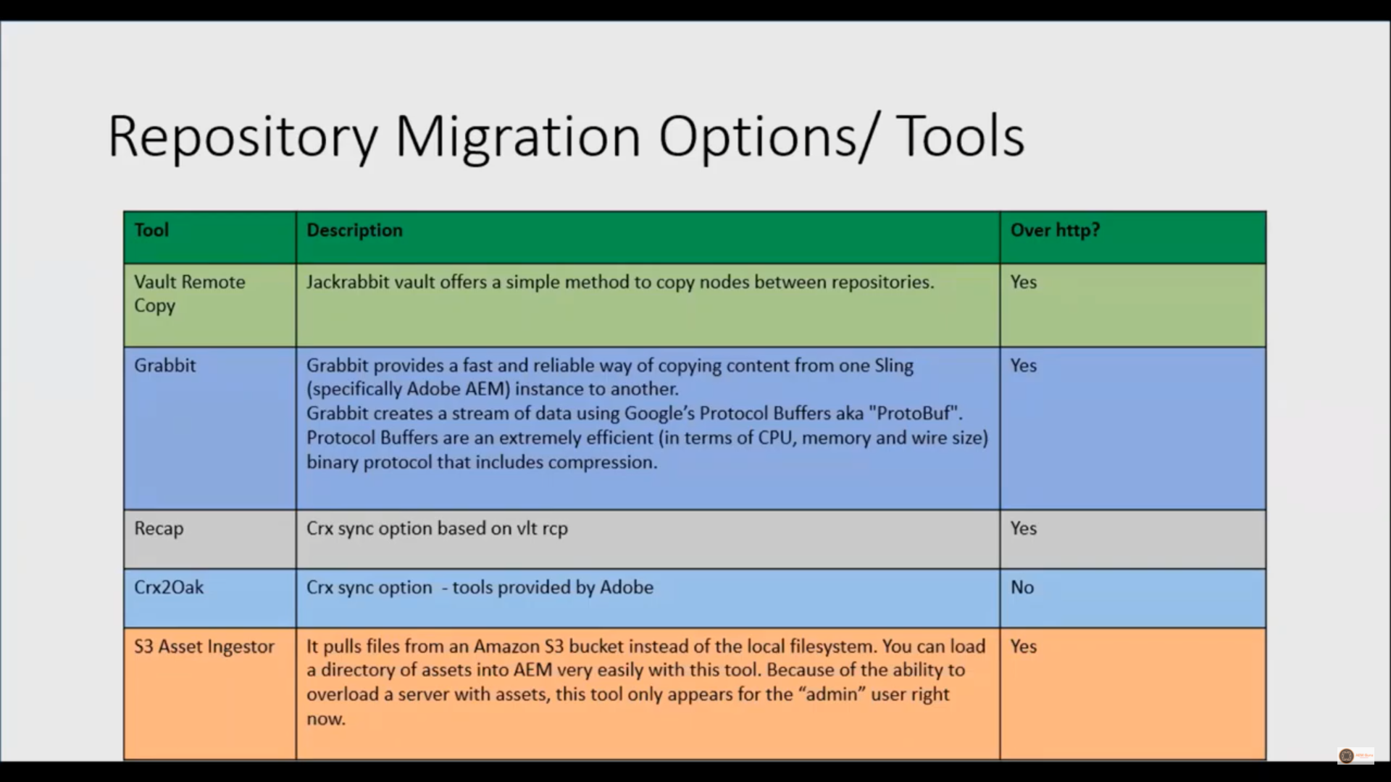
Migration Tool

Slide 5
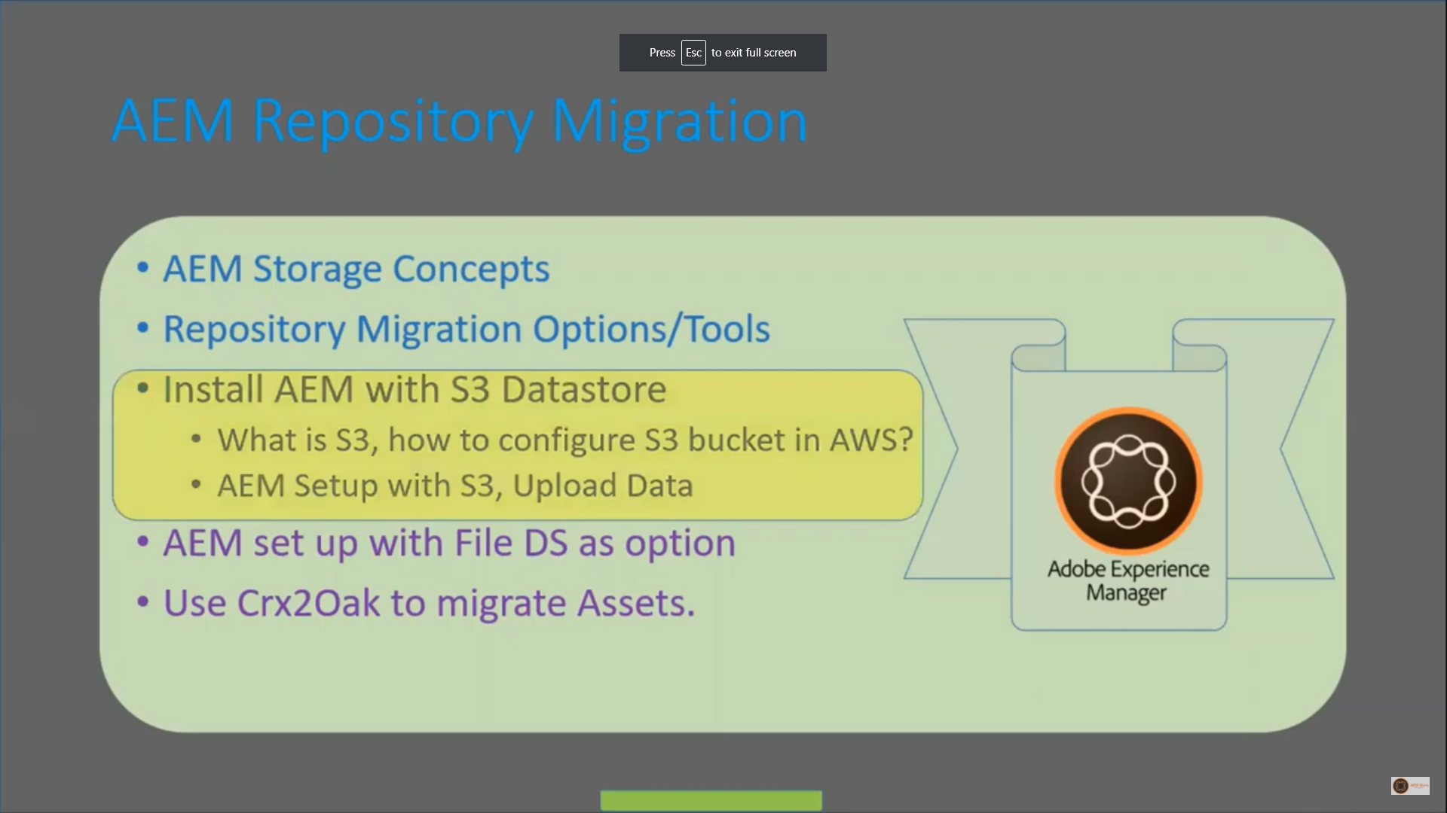
Install AEM with S3

Slide 6
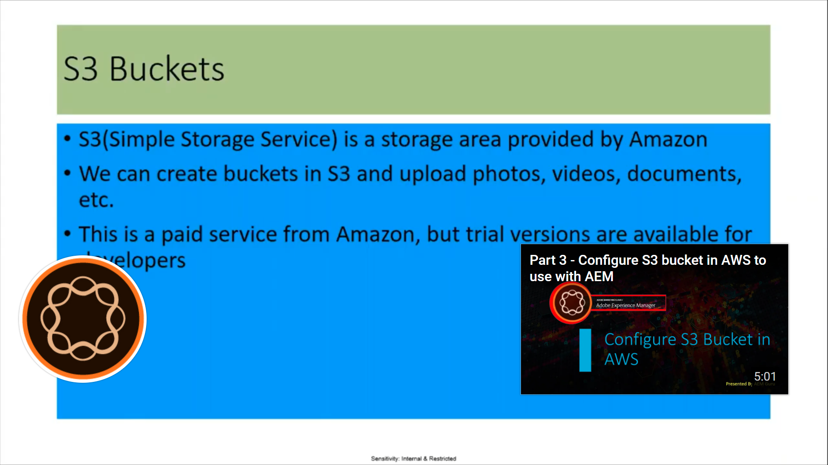
S3 Buckets

Slide 7
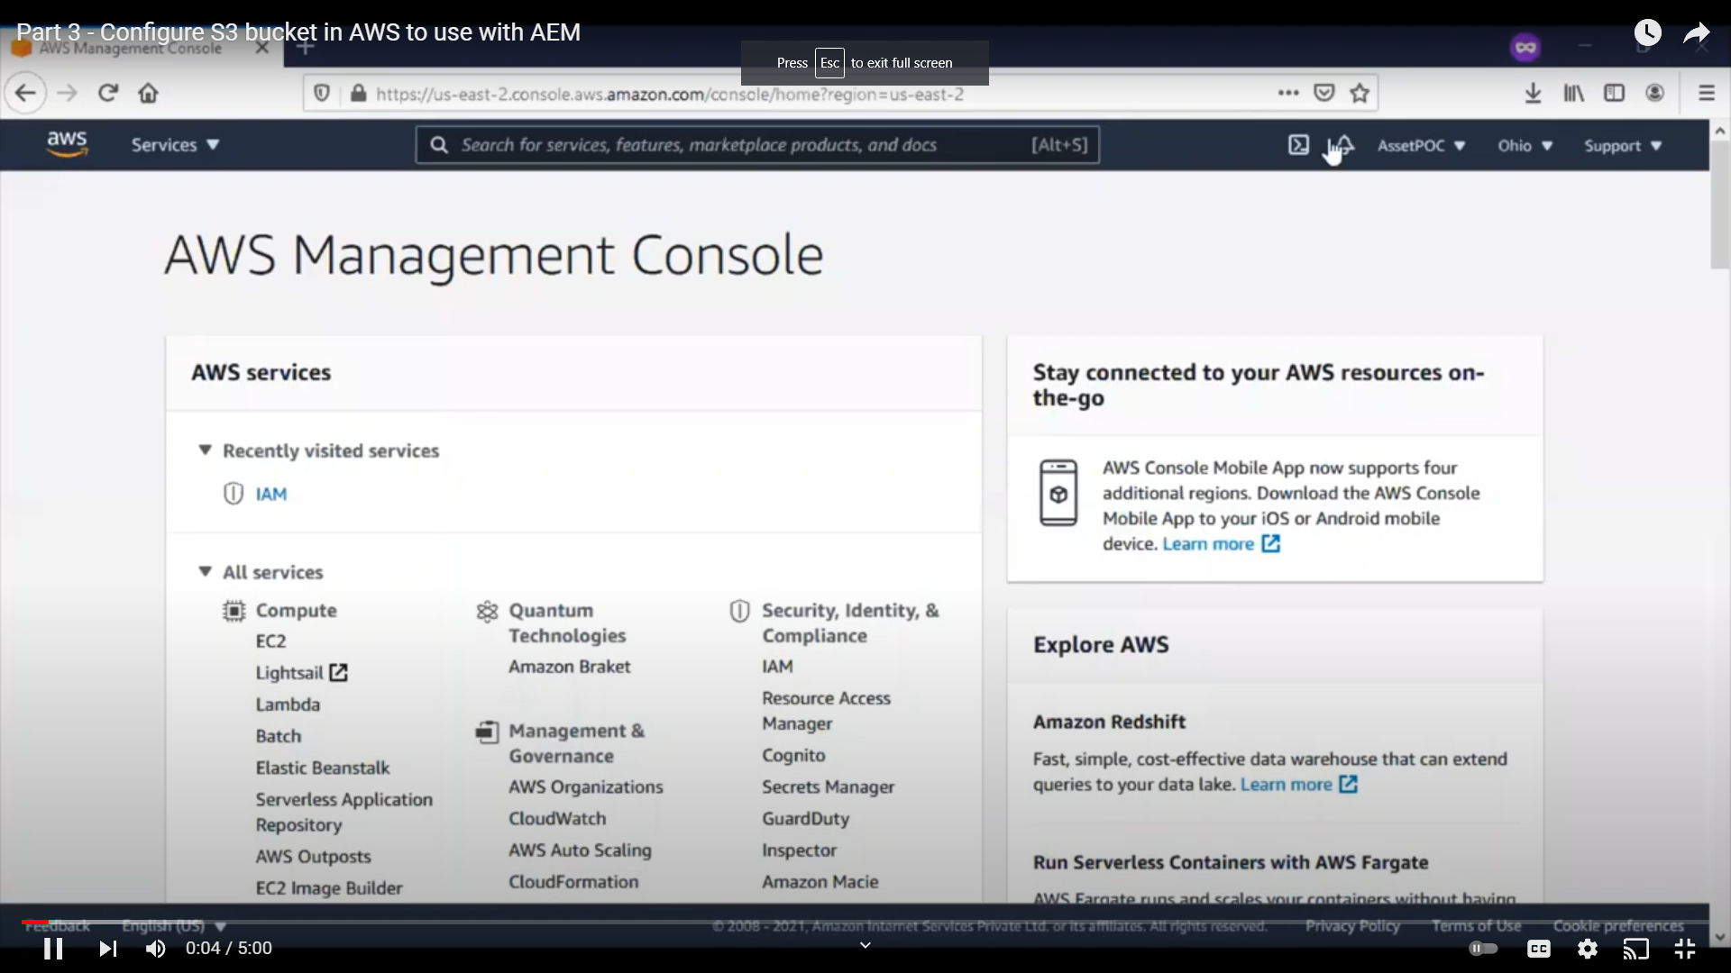
AWS Magmt Console

Slide 8
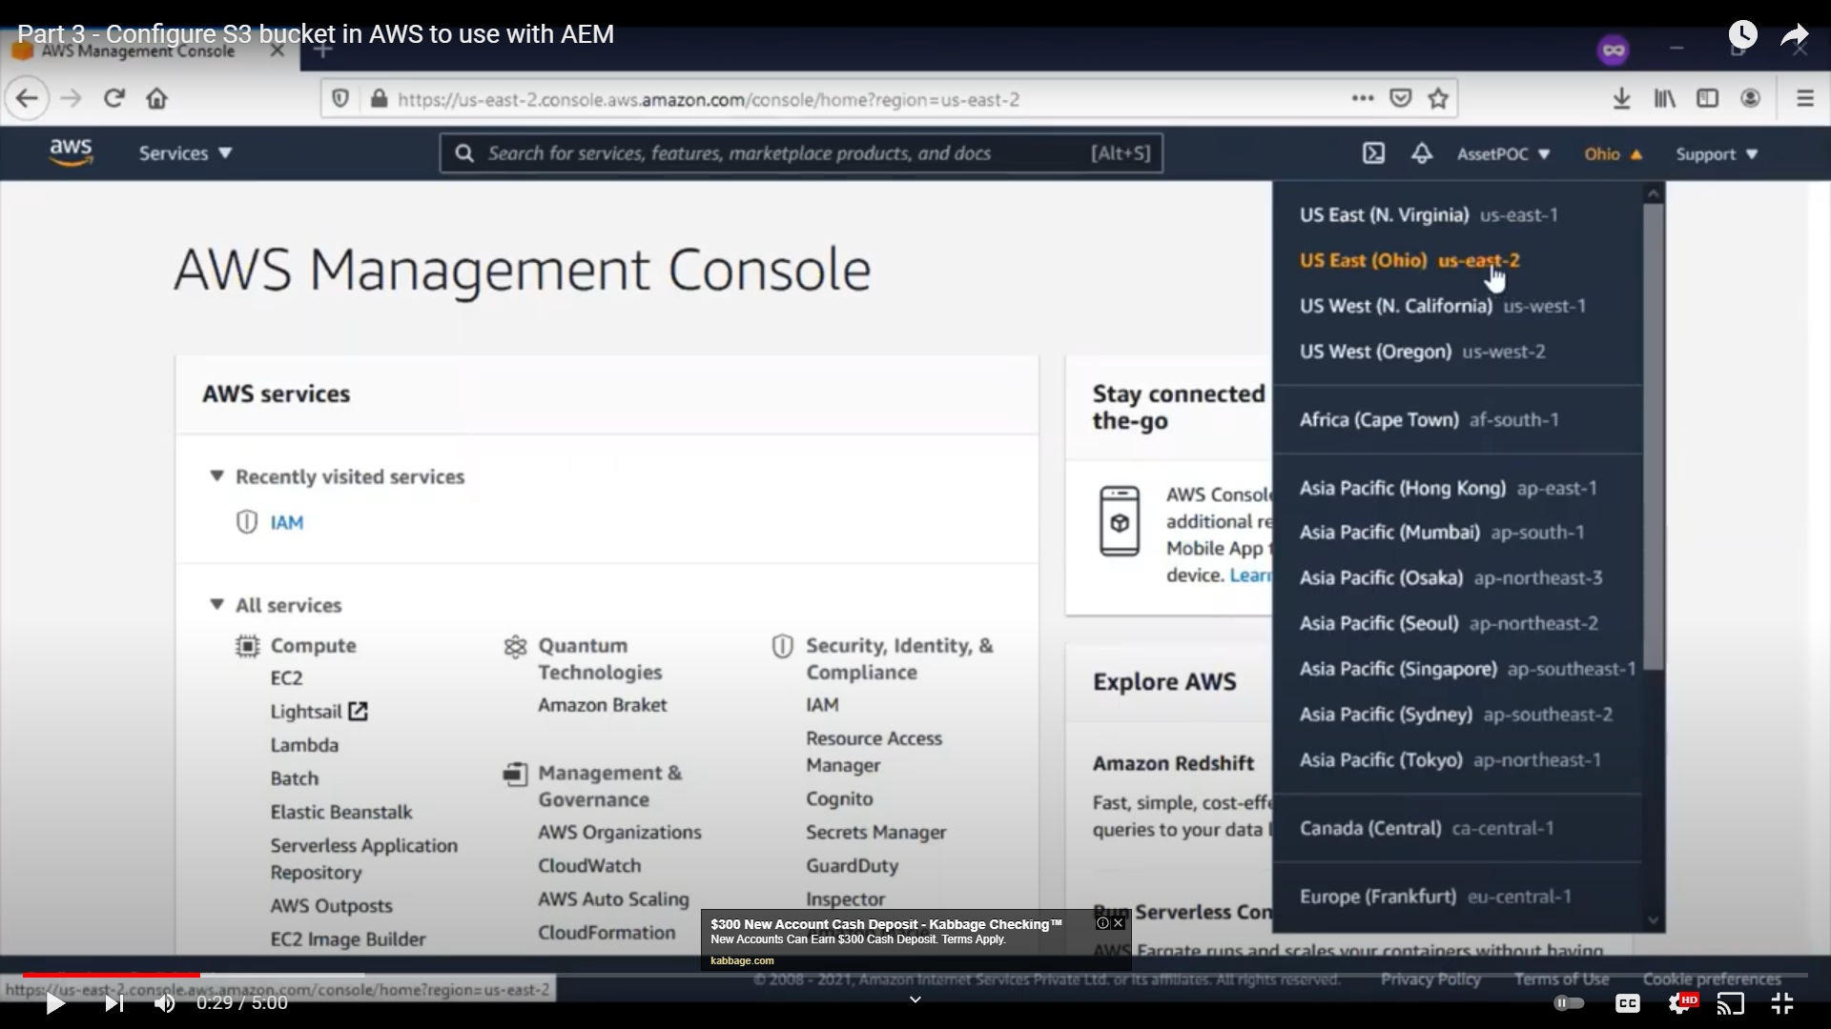
AWS Regions

Slide 9
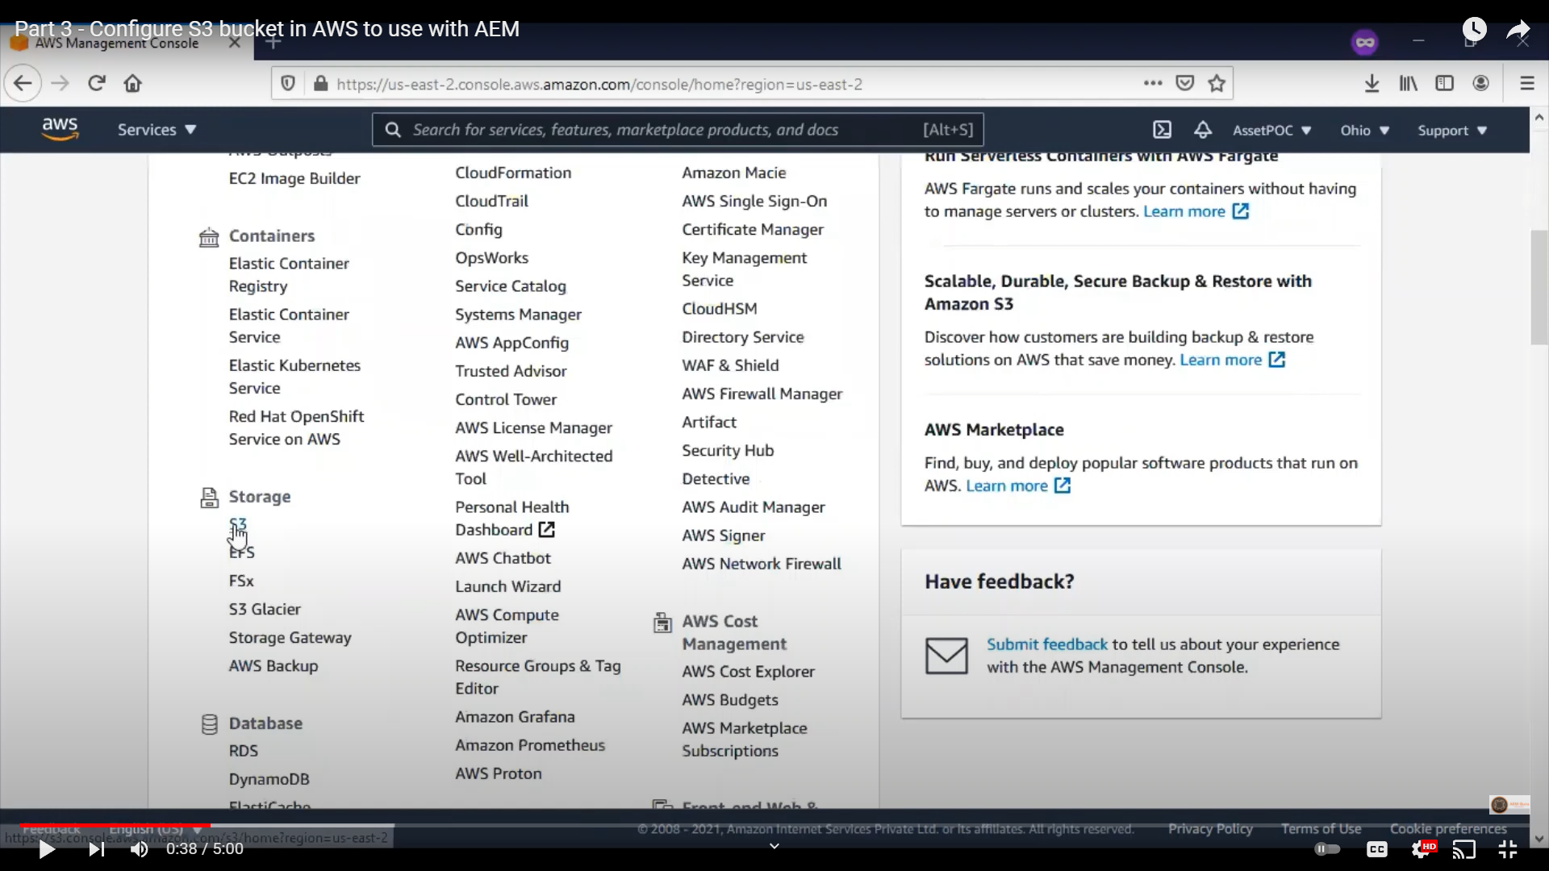
AWS S3

Slide 10
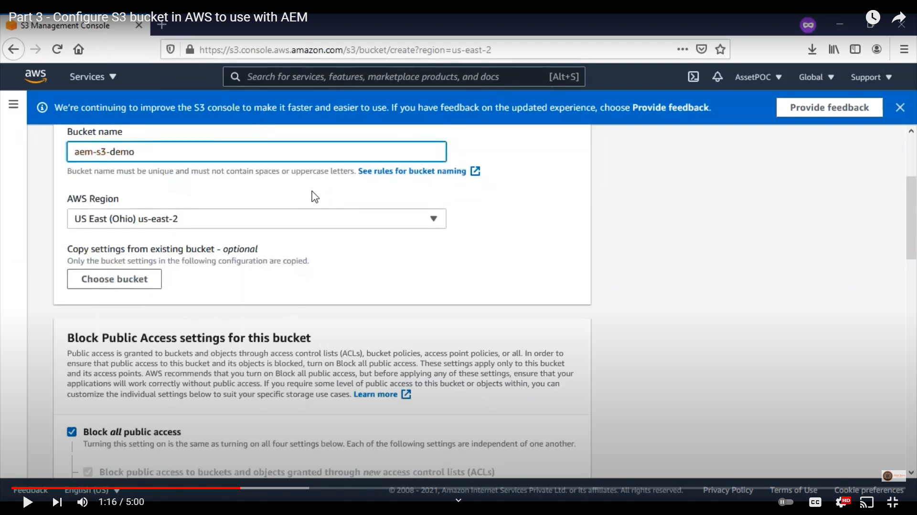
AWS S3 bucket

Slide 11
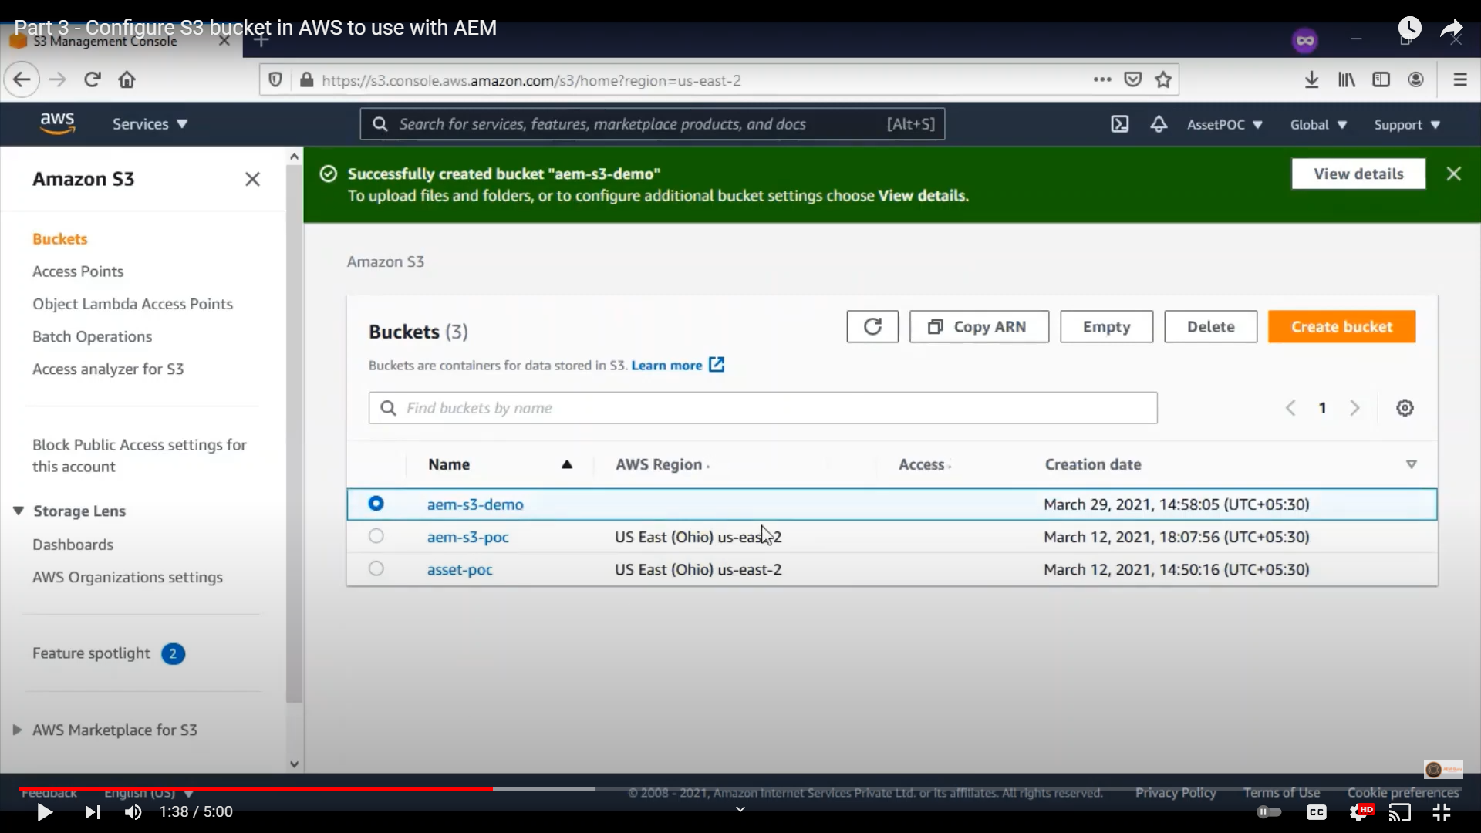
AWS S3 bucket creation

Slide 12
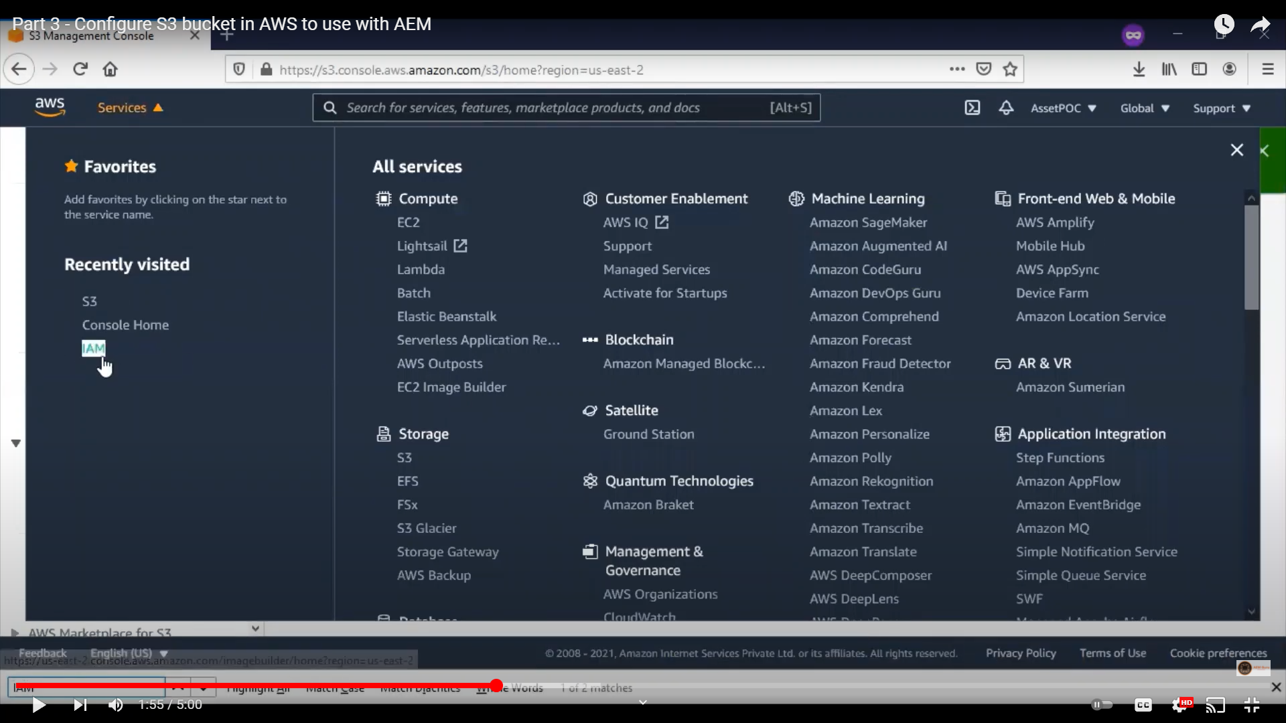
IAM

Slide 13
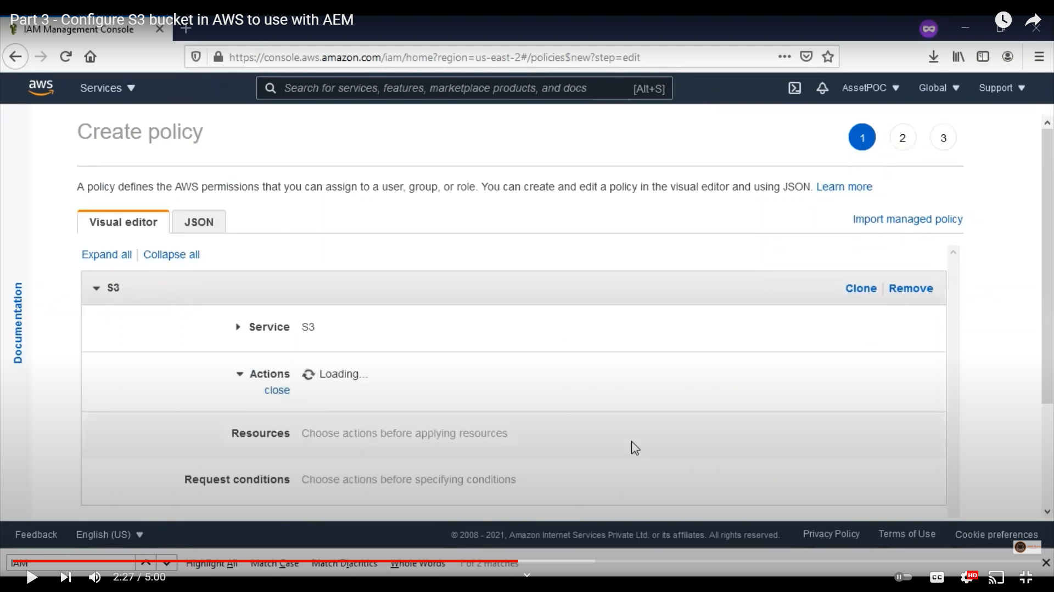
S3 Policy

Slide 14
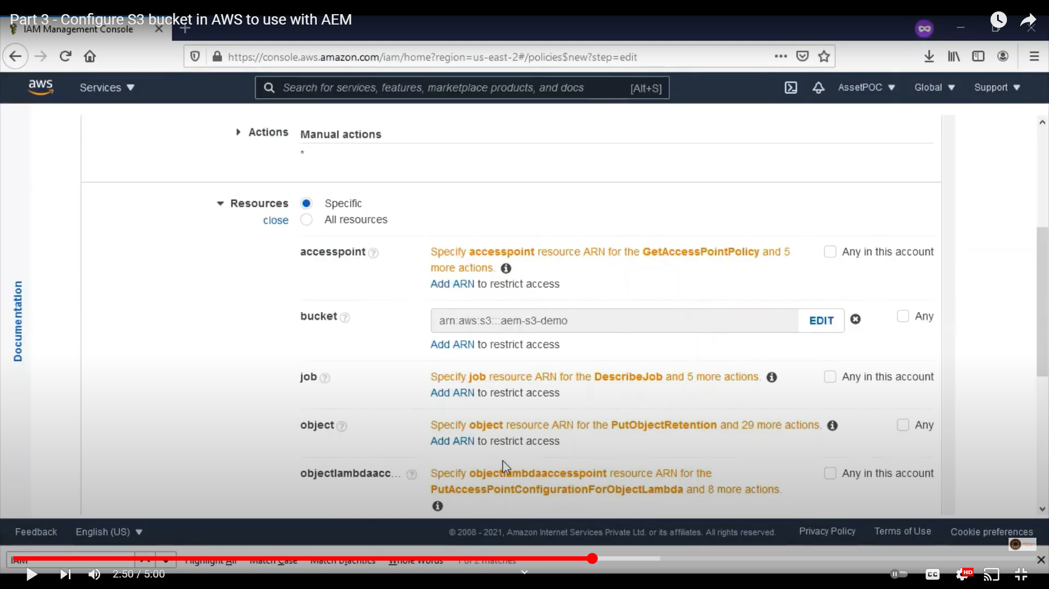
Mapping S3 Bucket with Policy

Slide 15
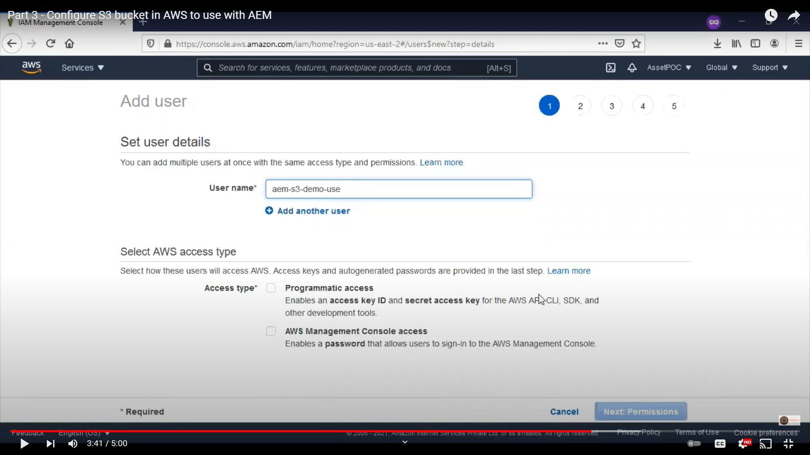
AWS add user

Slide 16
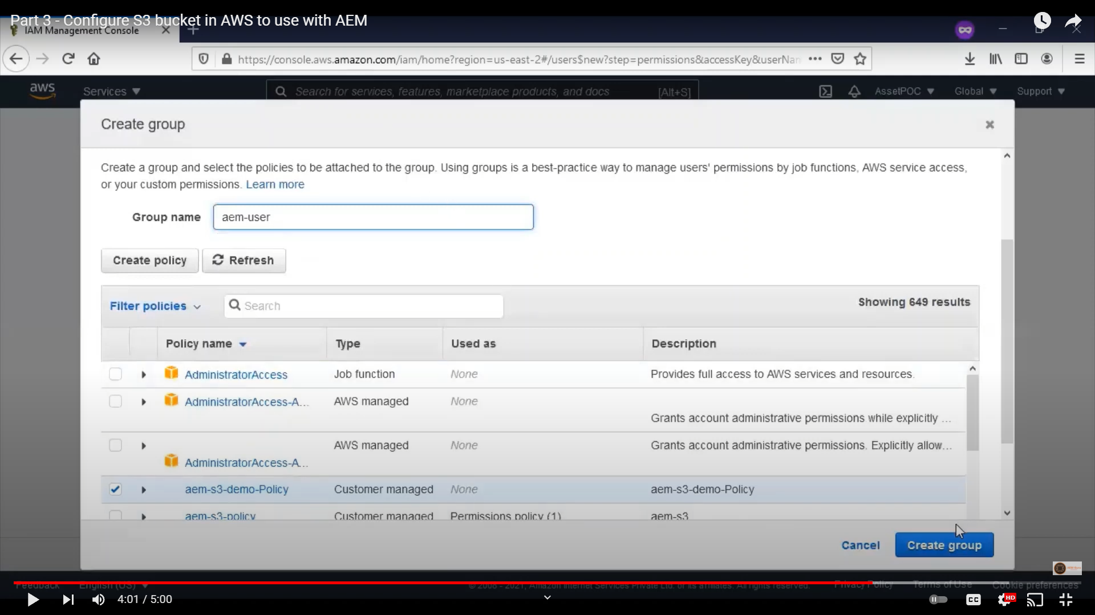
S3 group

Slide 17
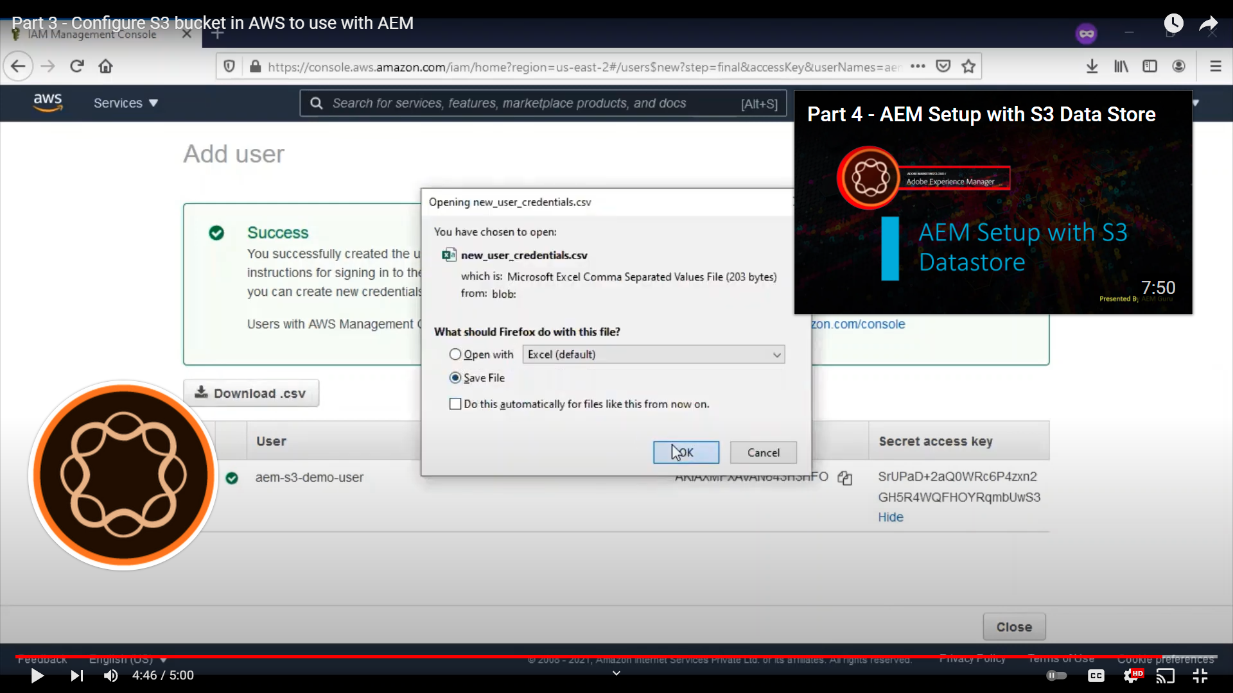
S3 credientials

Slide 18
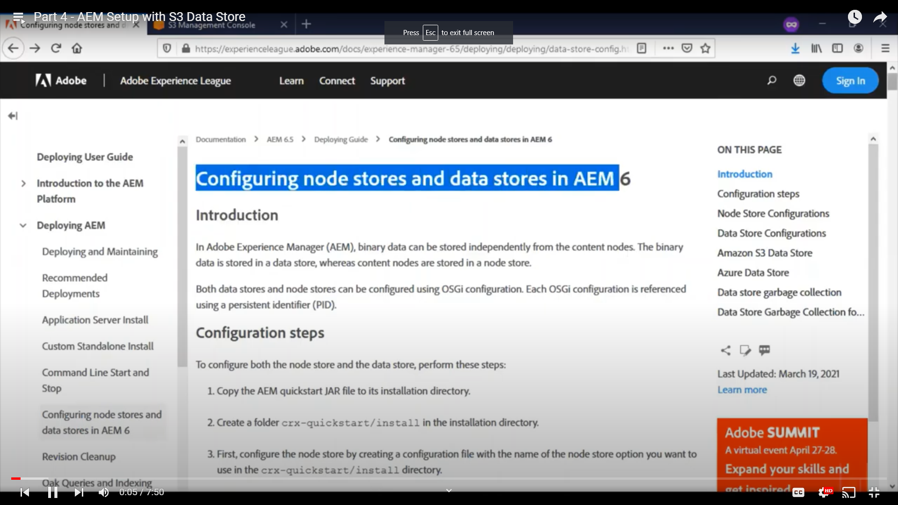
AEM config Doc

Slide 19
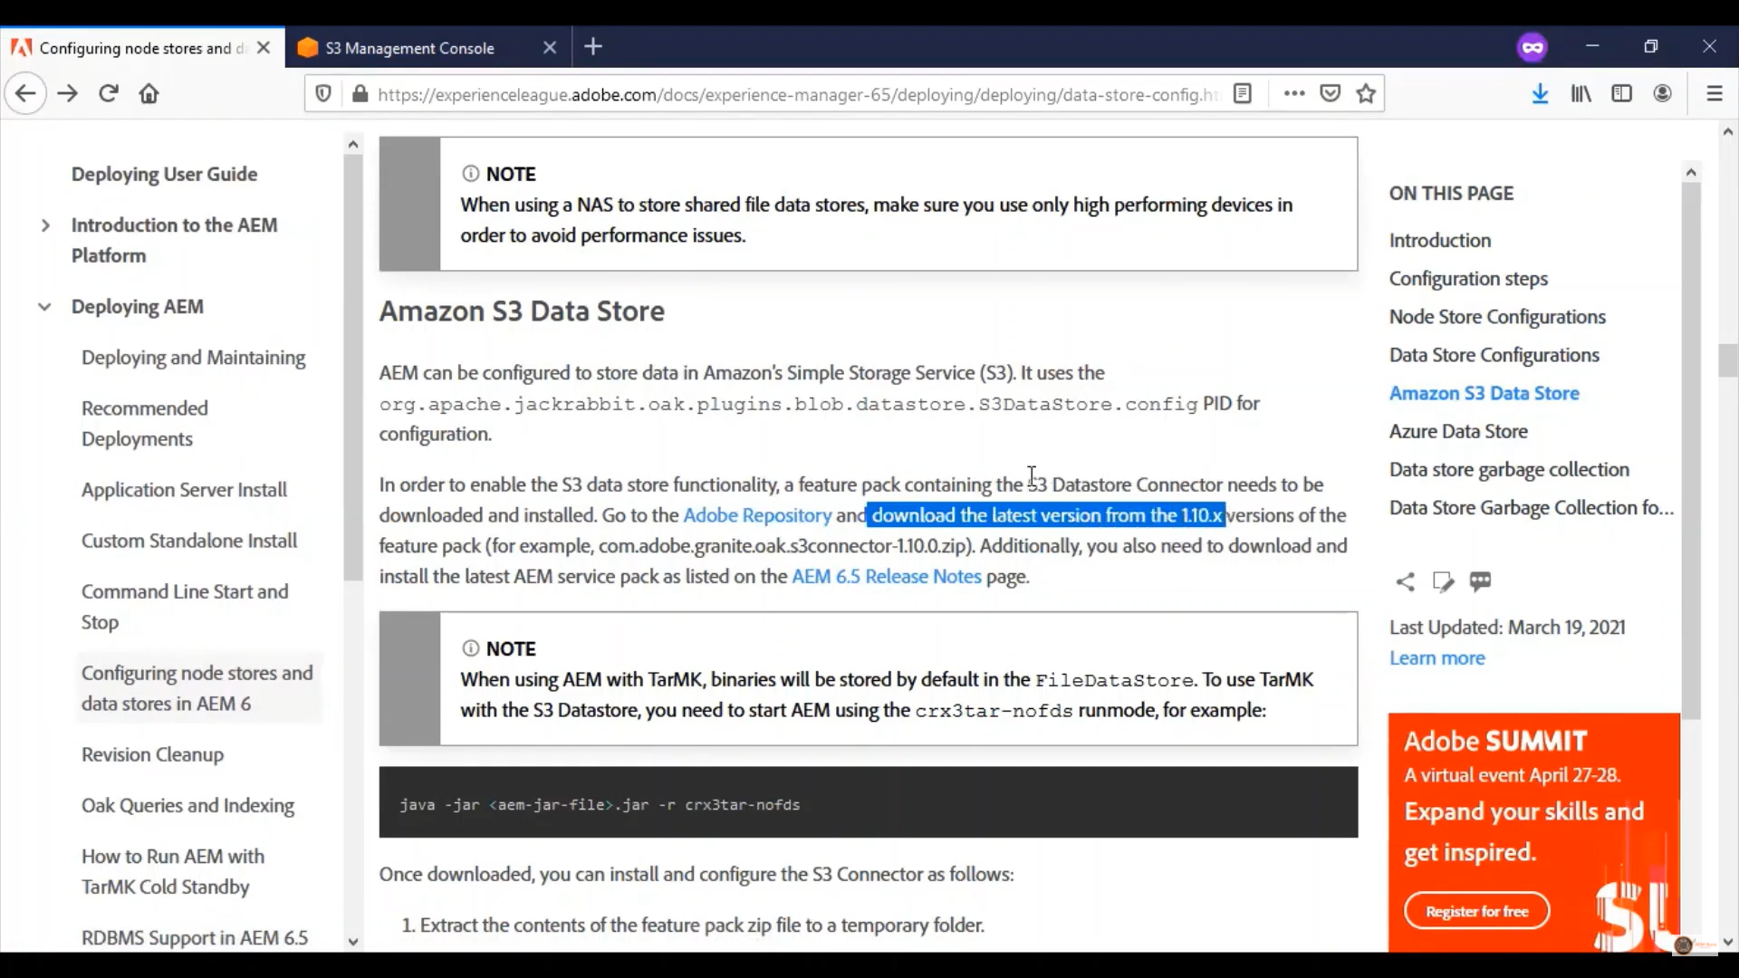
AEM S3 doc

Slide 20
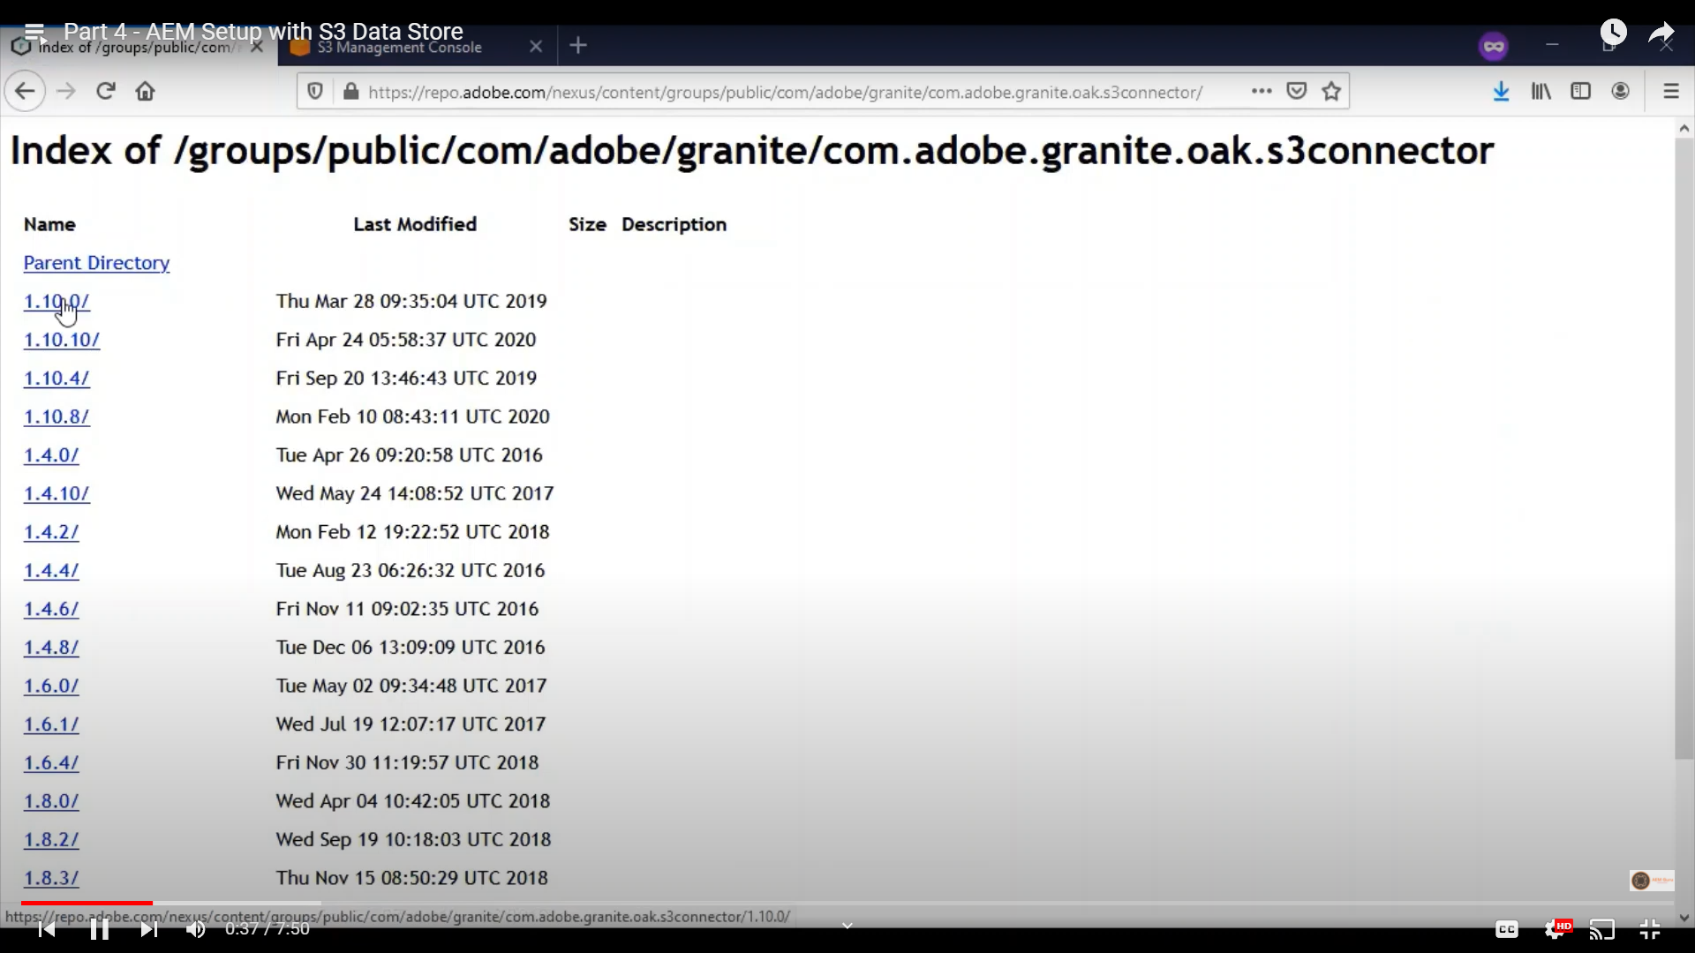
Download S3 connector

Slide 21
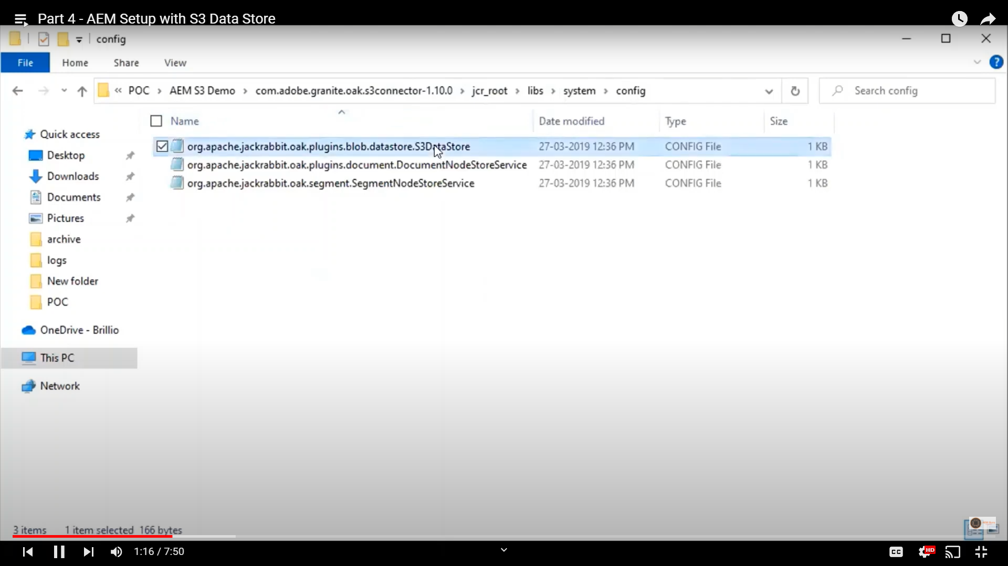
Config S3 Data Store

Slide 22
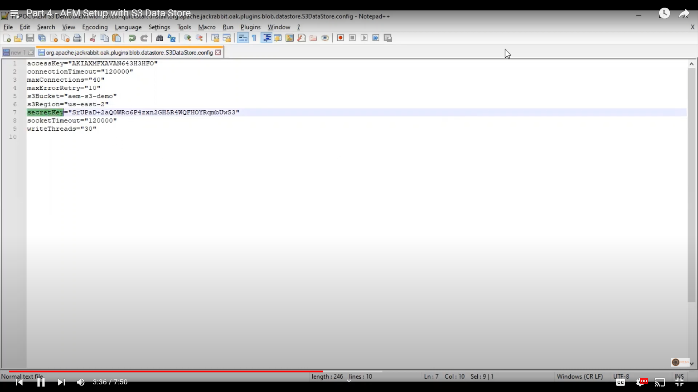
AEM config updates

Slide 23
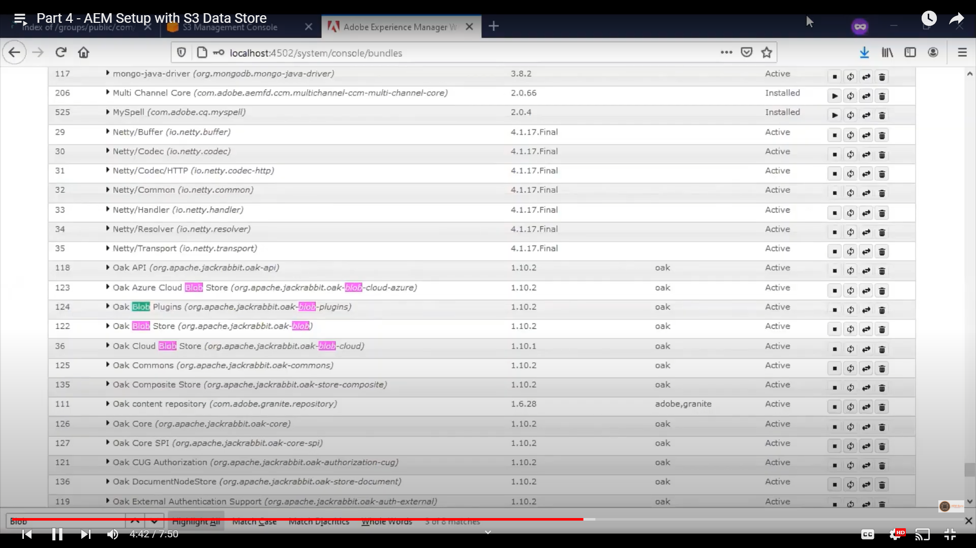
AEM osgi bundle

Slide 24
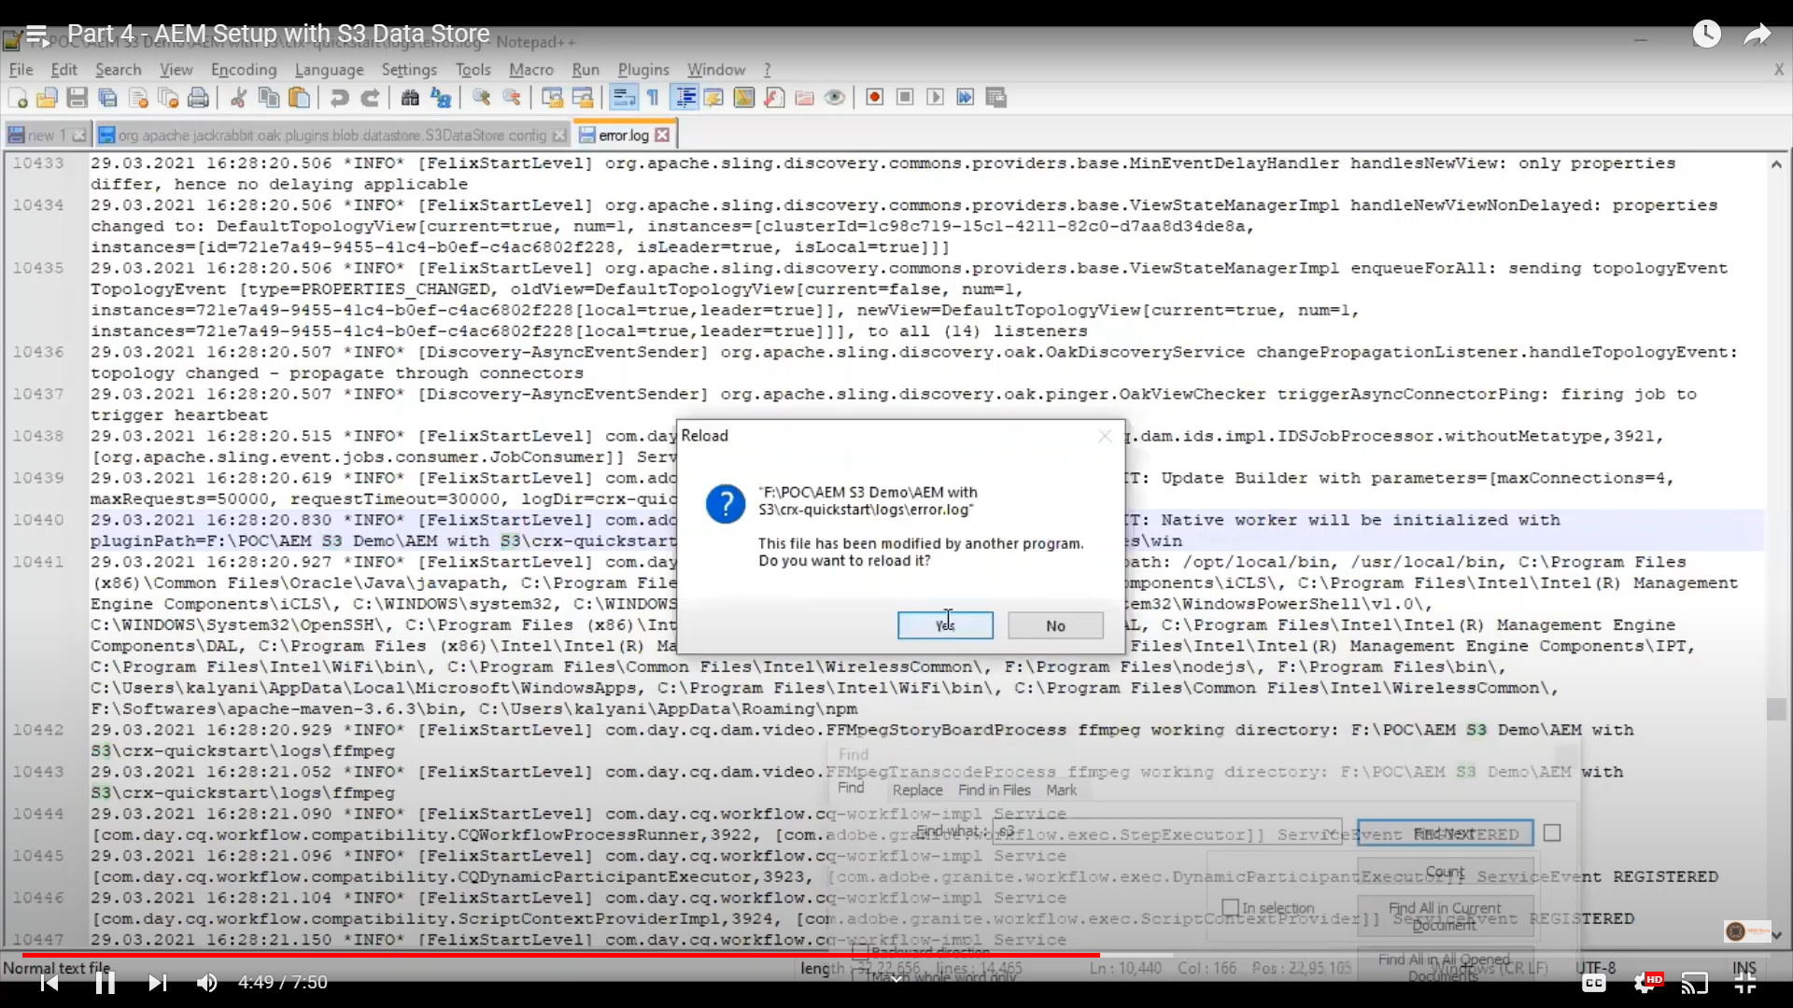
AEM Log

Slide 25
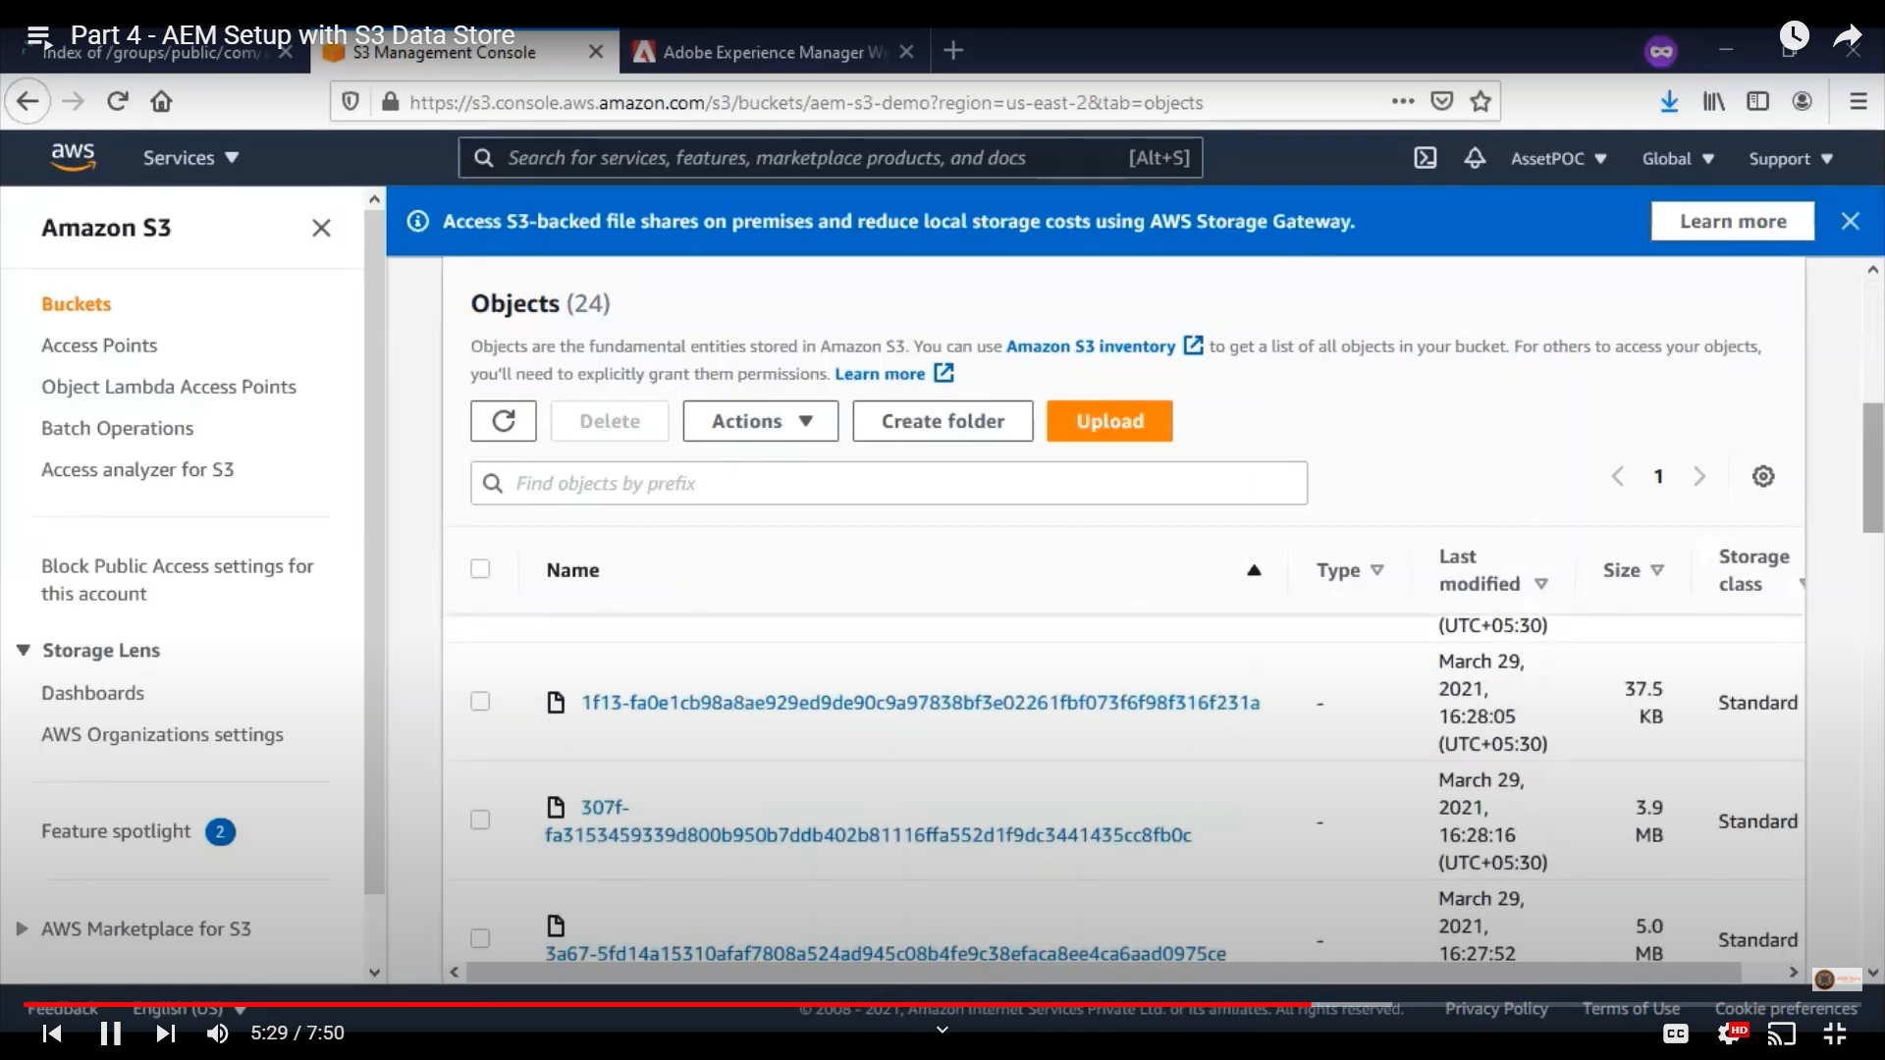
AWS S3 buket with objects

Slide 26
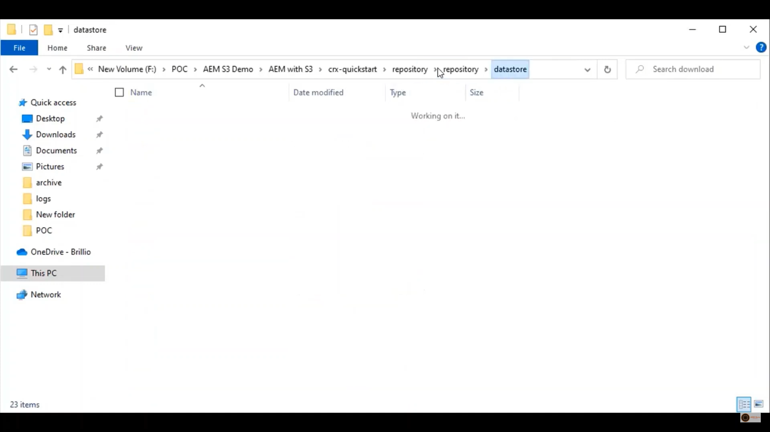
AEM Repository datastore loc

Slide 27
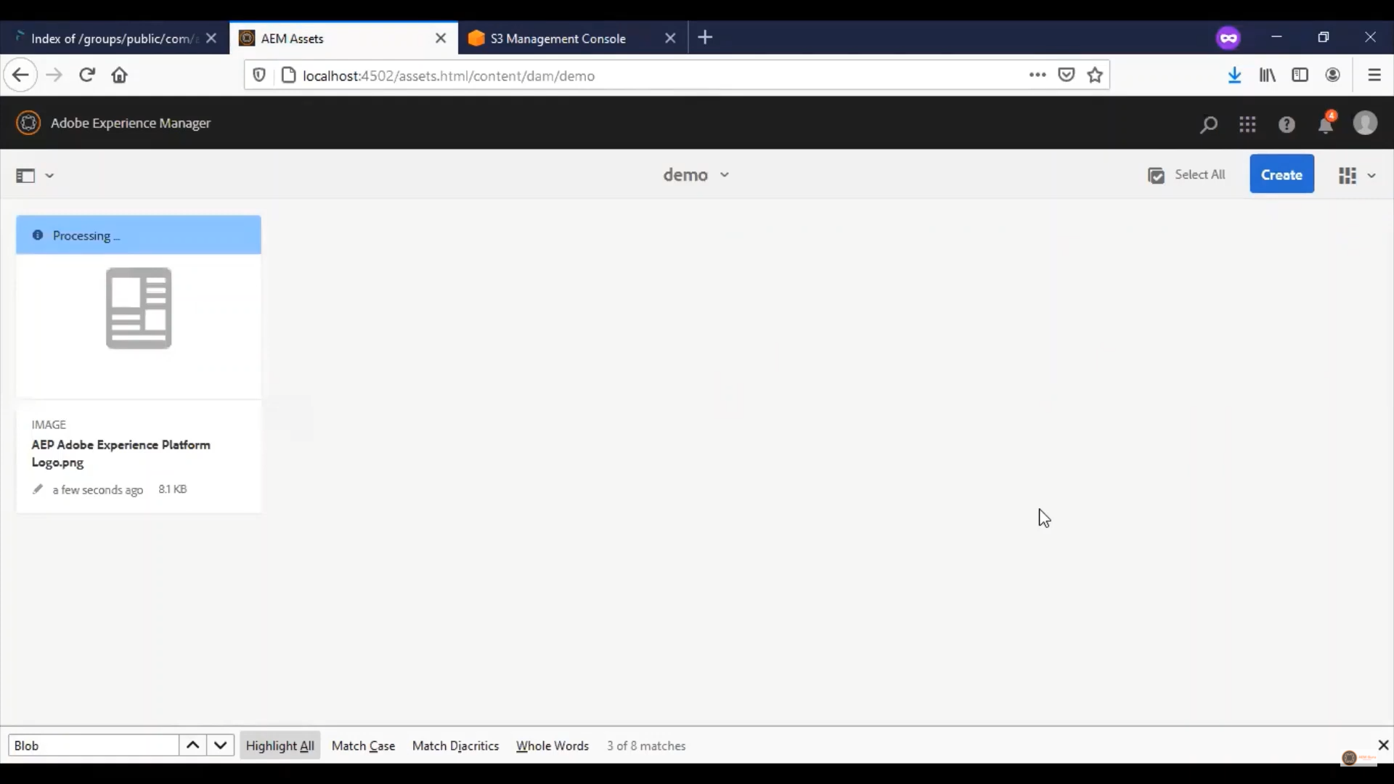
AEM upload DAM asset

Slide 28
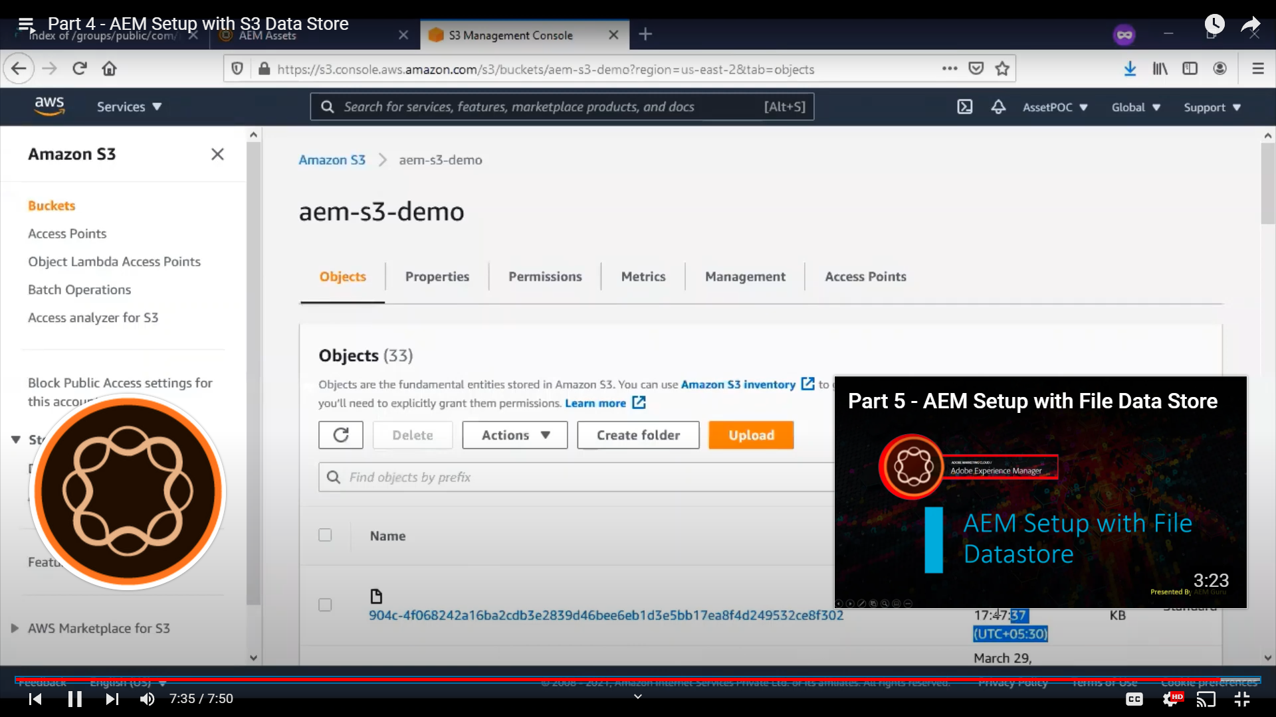
Pushed to S3 result

Slide 29
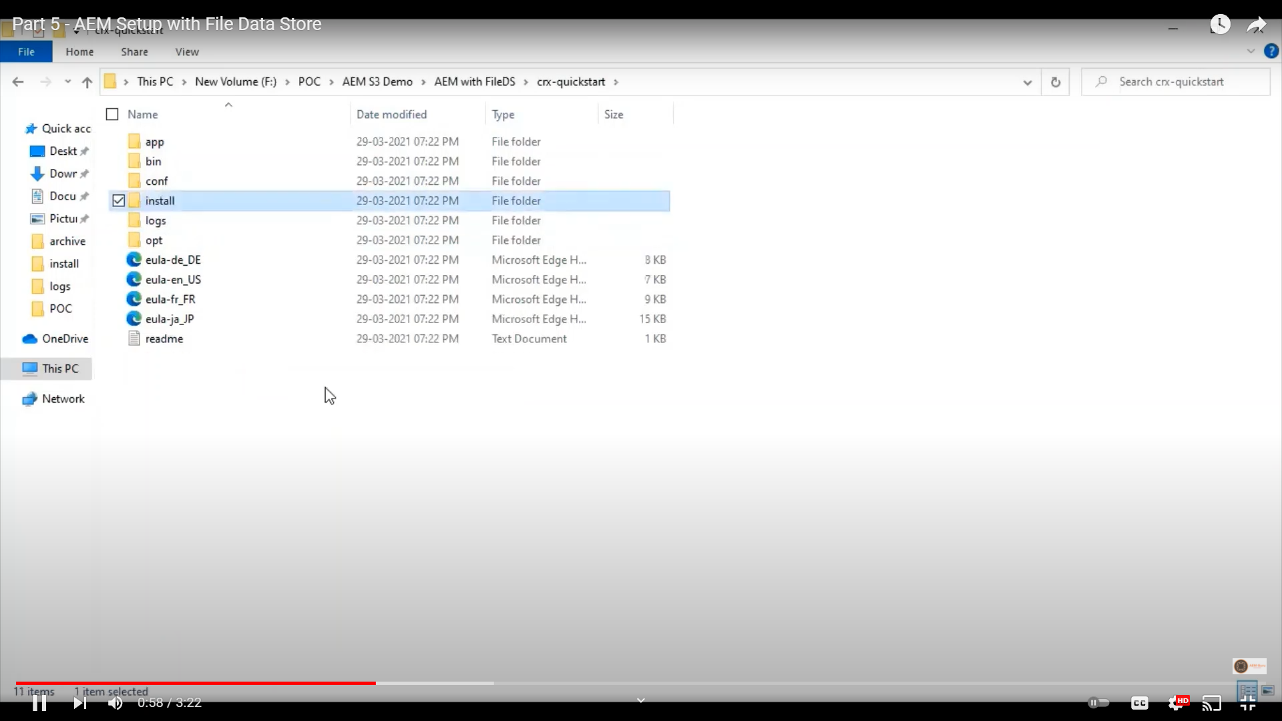
AEM with File Data Store

Slide 30
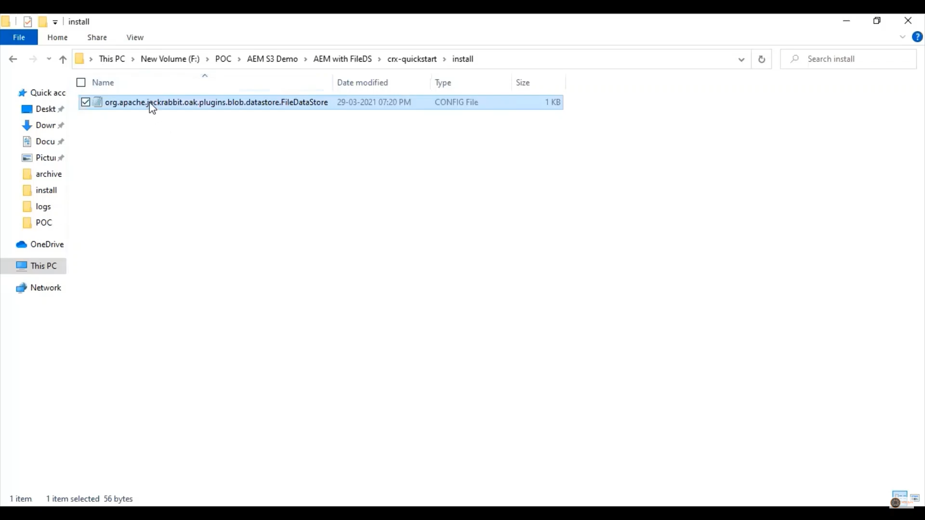
AEM file data store loc

Slide 31
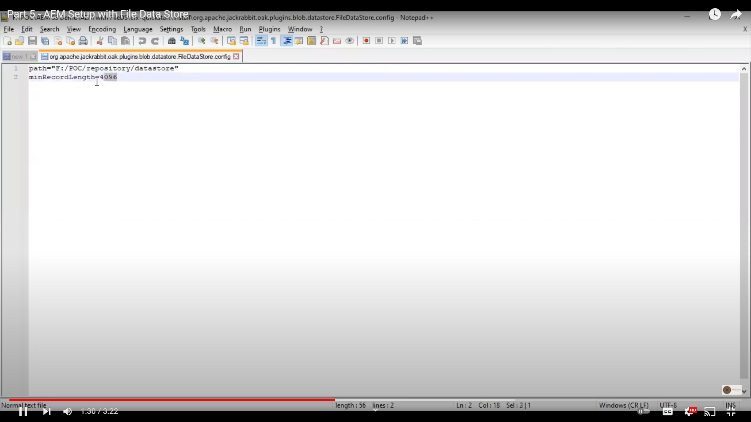
AEM filedatastore config path

Slide 32
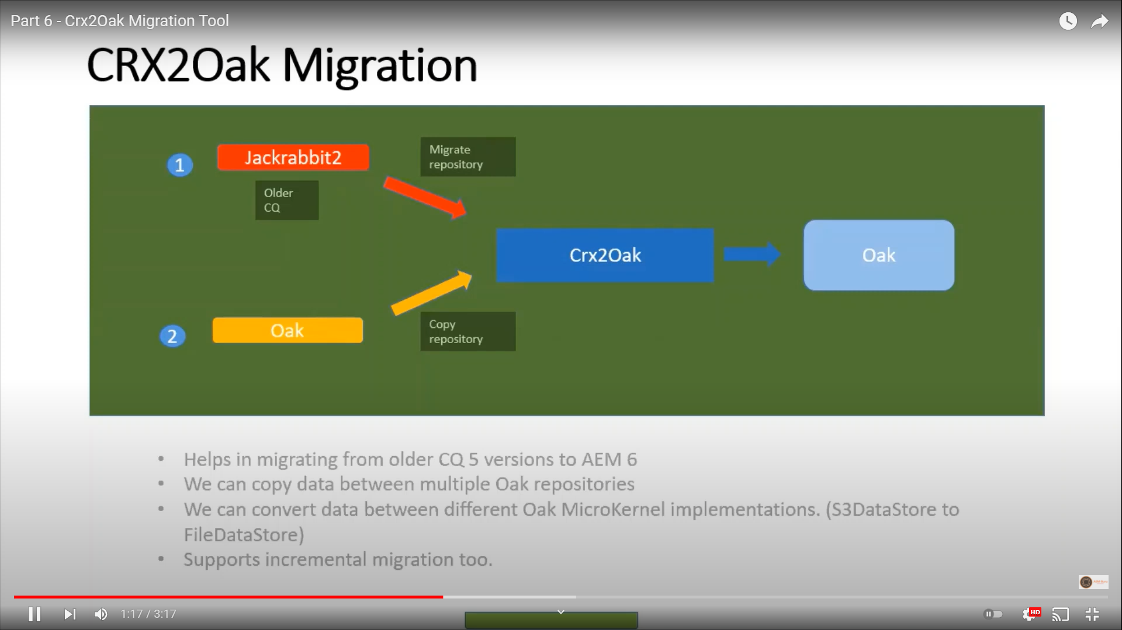
CRX2Oak tool

Slide 33
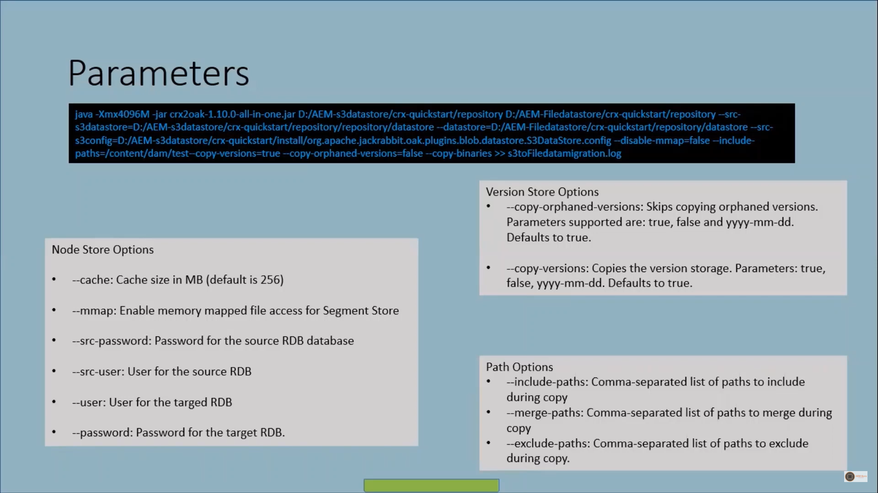
Oak Parameters

Slide 34
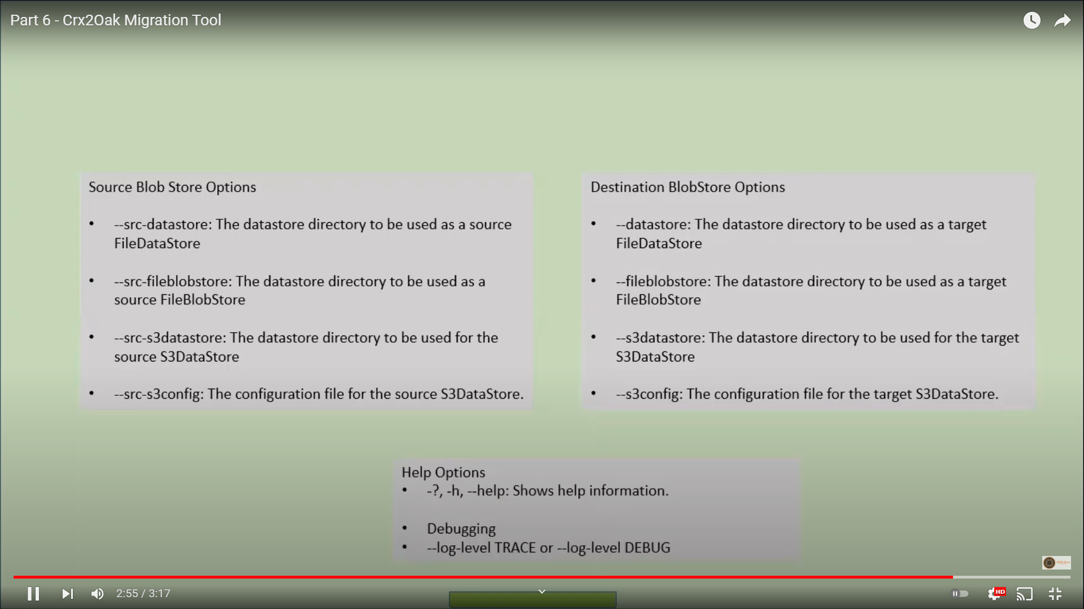
AEM source destin blob store

Slide 35
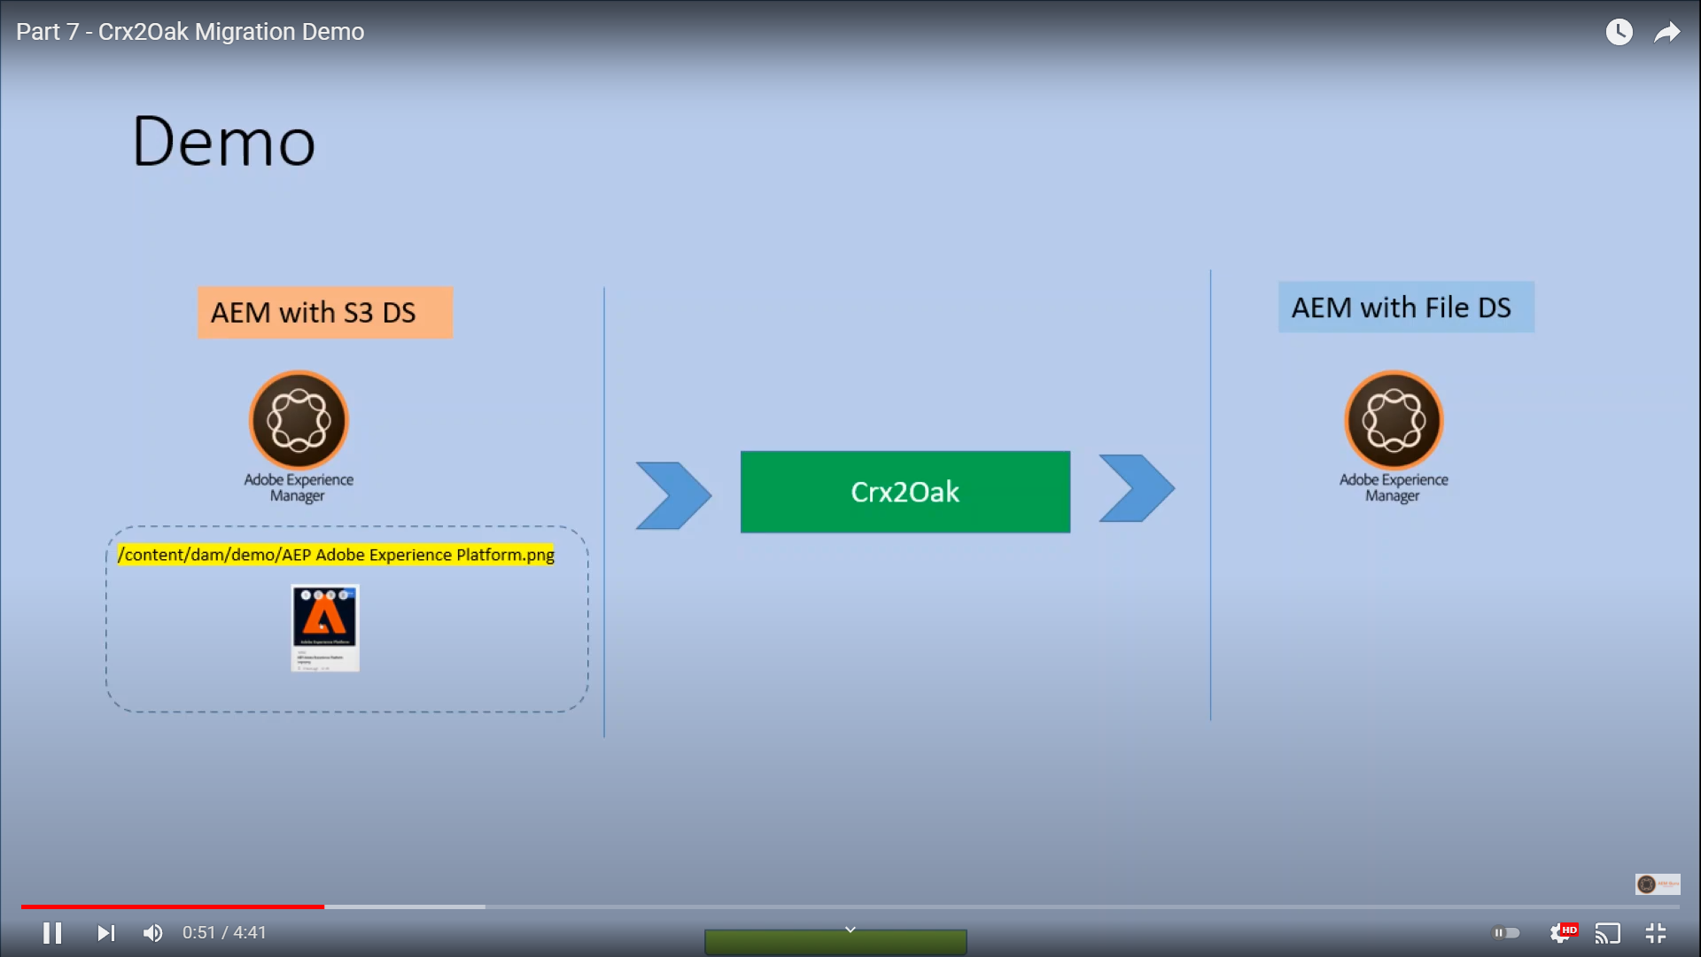
AEM S3 to File DS

Slide 36
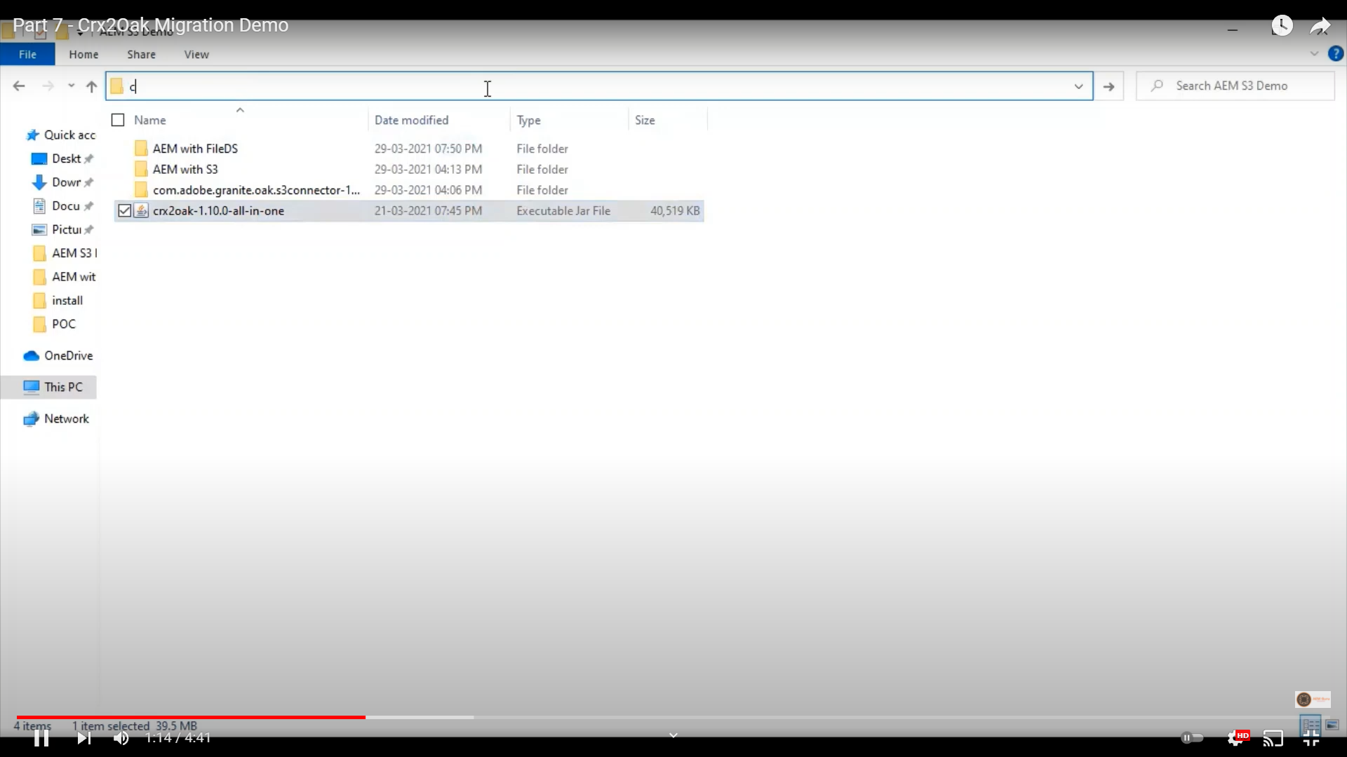
AEM CRX2oak location

Slide 37
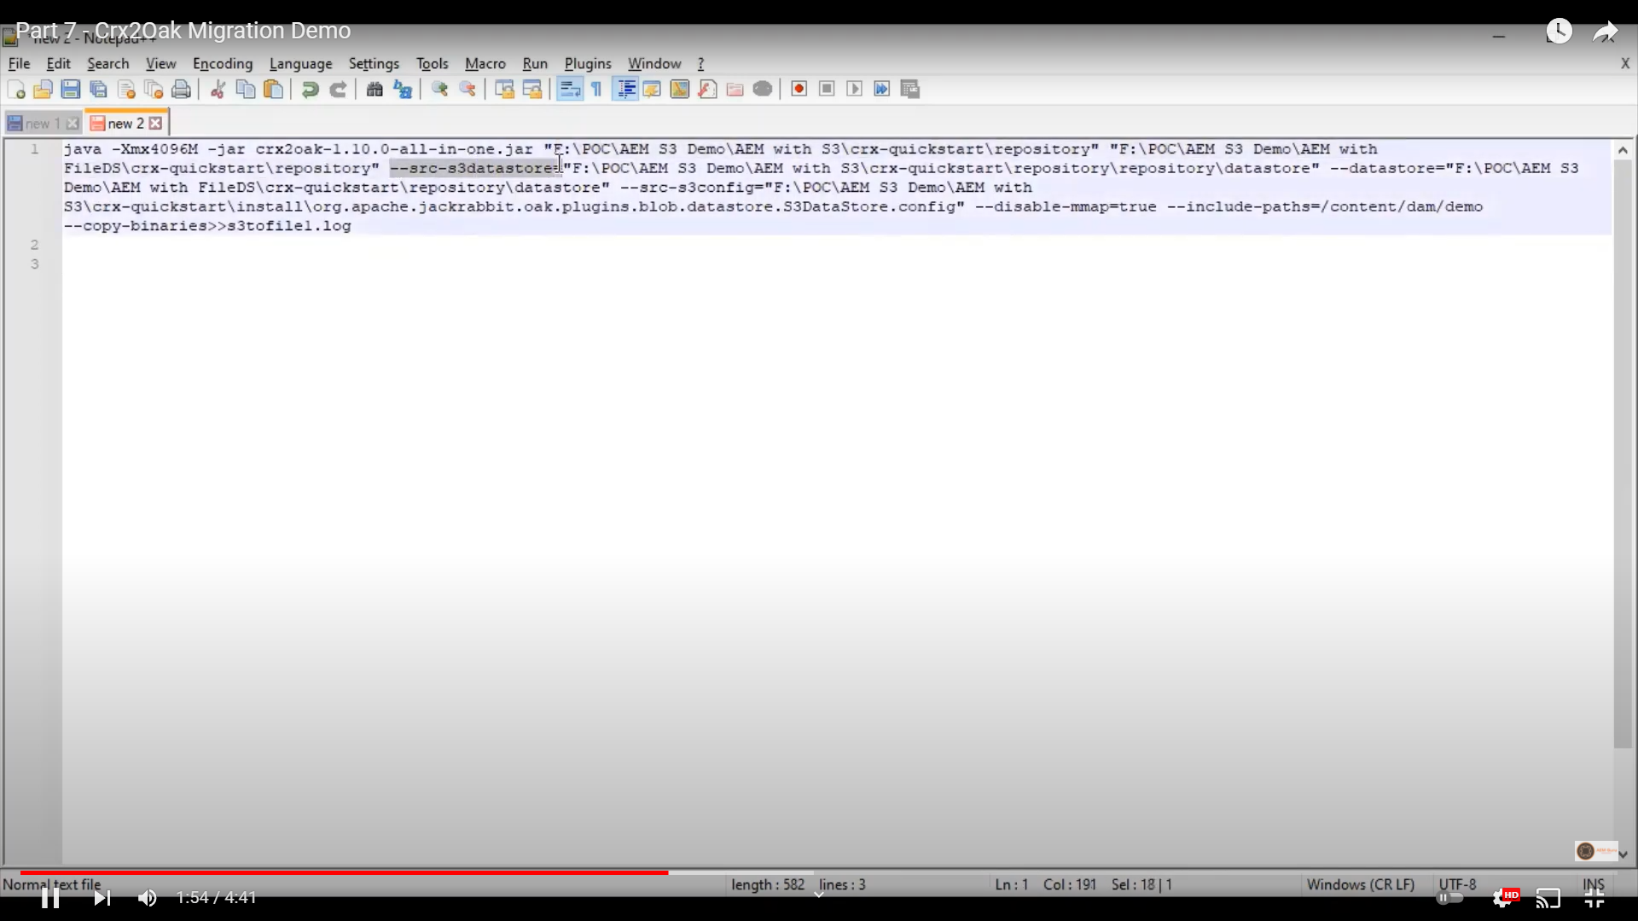
AEM crx2oak parameters

Slide 38
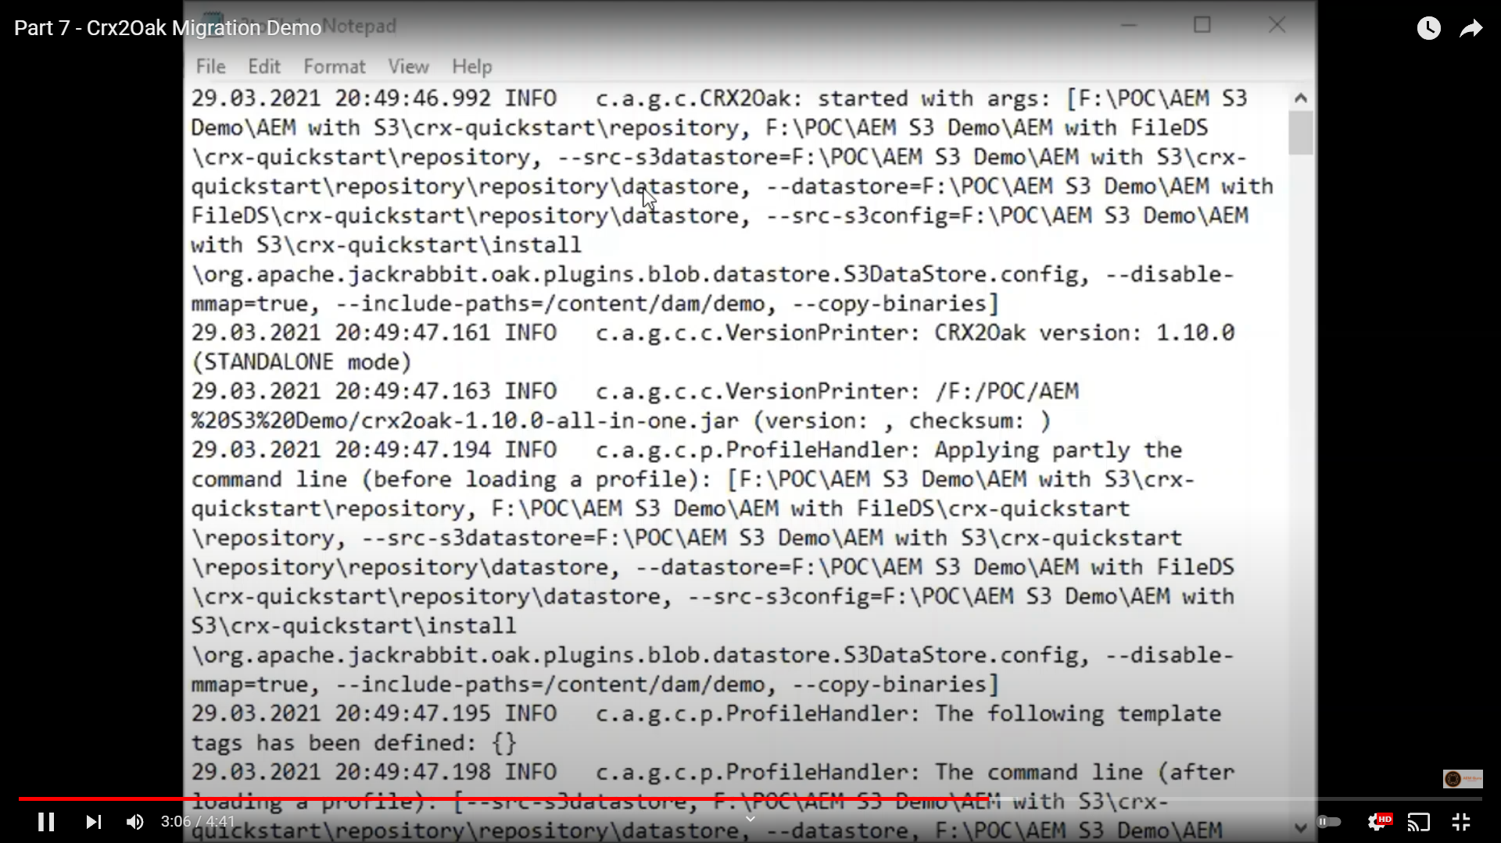
AEM log

Slide 39
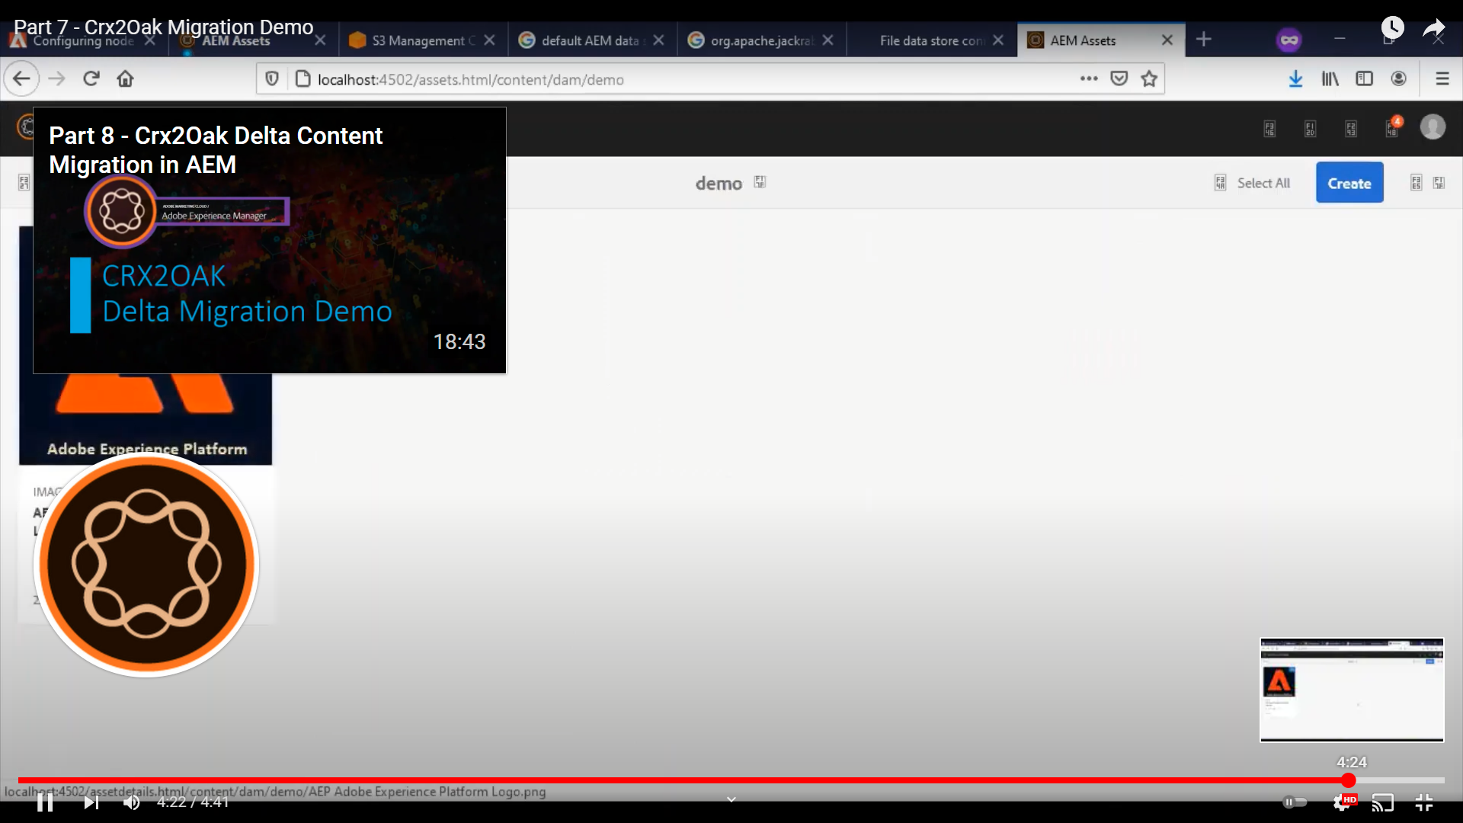
AEM result in File DS

Slide 40
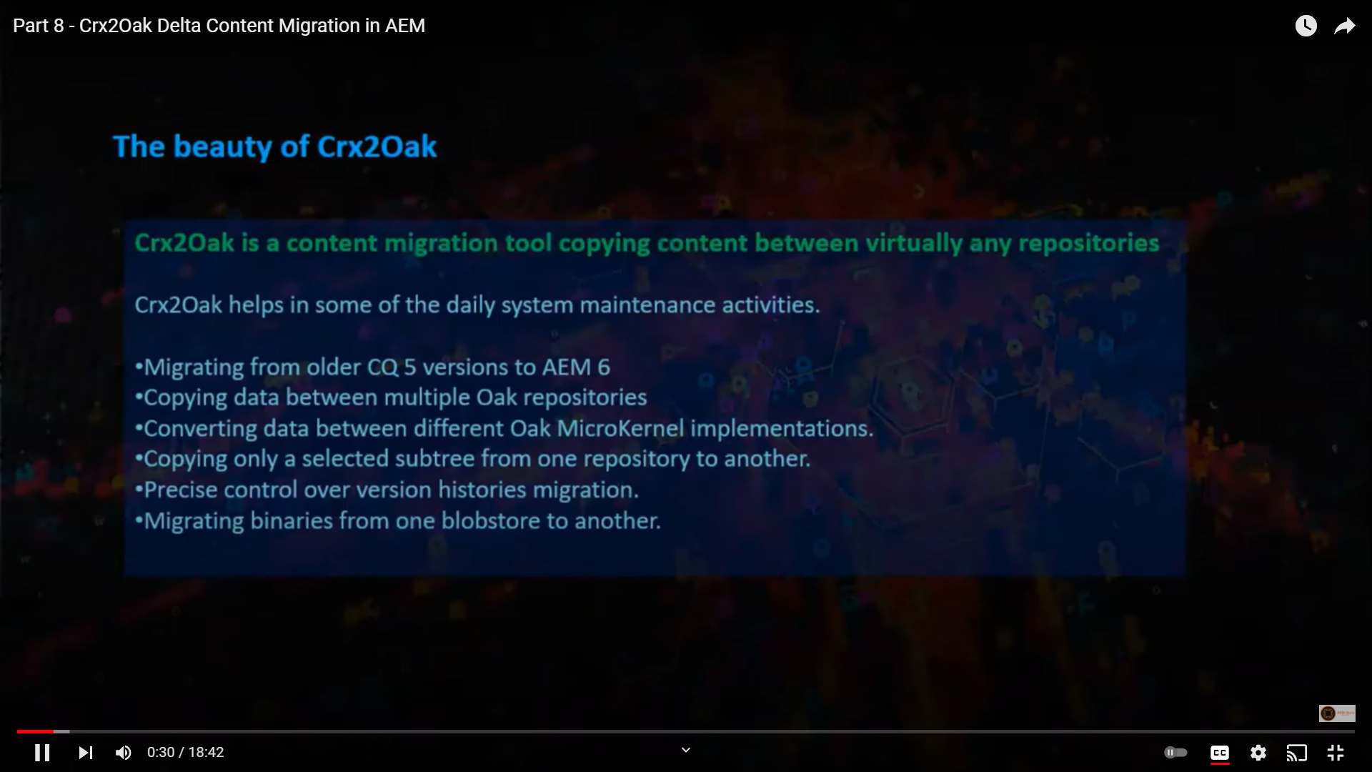
AEM CRX2oak Delta

Slide 41
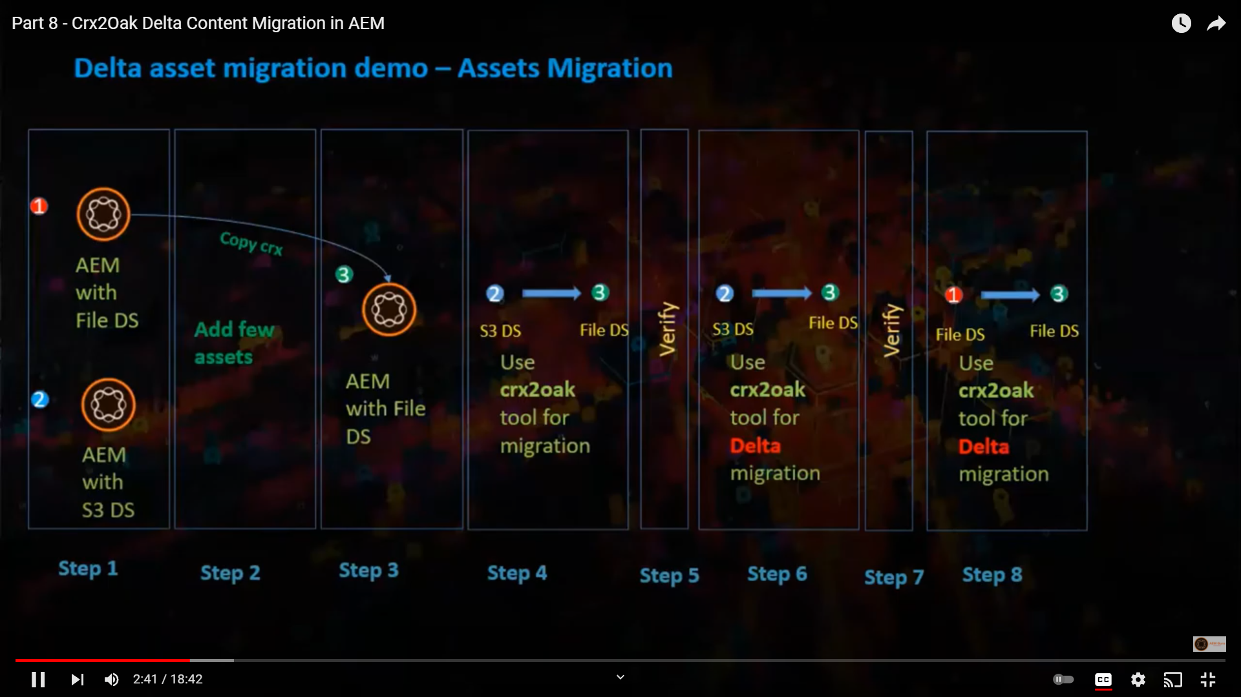
AEM CRX2oak Delta Steps

Slide 42
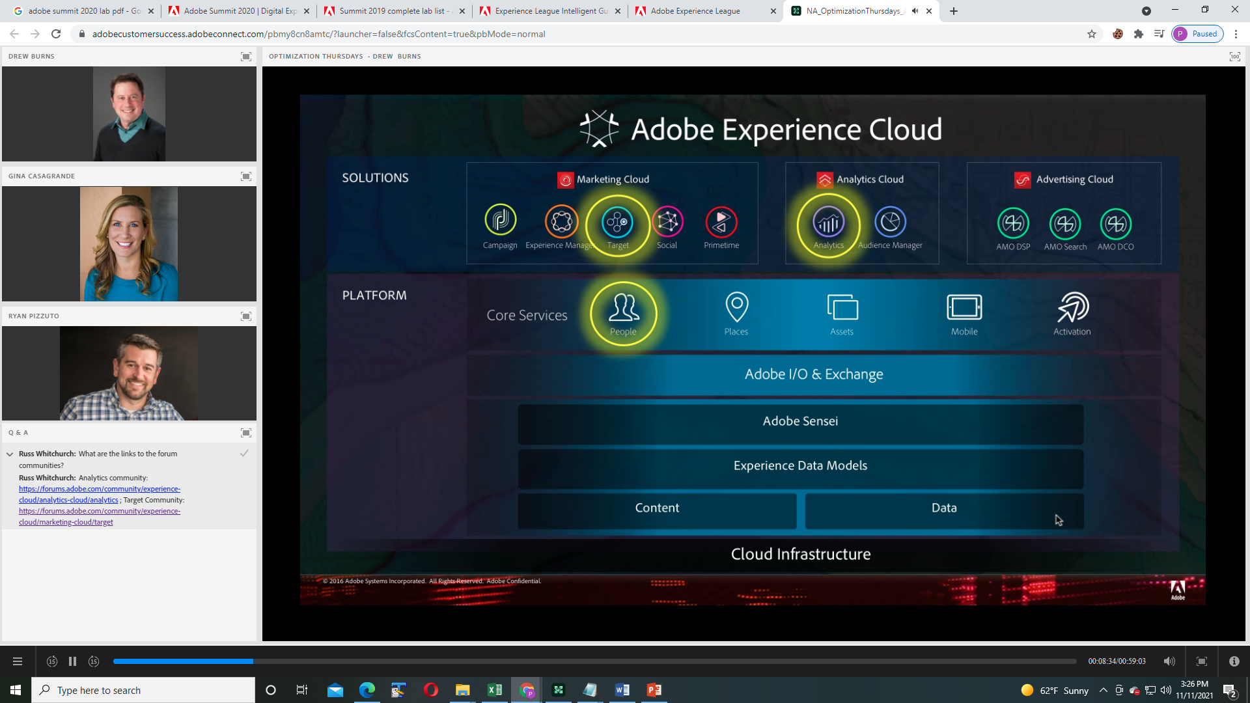
AEM Repository Binary vs Content

